Slide 1
CBHC | RCAHMW
Archaeology at your Fingertips
Archaeology at your Fingertips
A guide to online resources for archaeology & heritage
Jon Dollery

Slide 2
A whistle stop tour of Welsh Digital Heritage
CBHC | RCAHMW
This talk will focus on the wealth of digital platforms that provide information relating to the archaeology and heritage of Wales. There is so much information out there that it is available to the armchair archaeologist. We will focus on the material and resources from:
Cadw (Welsh Government)
Royal Commission on the Ancient and Historical Monuments of Wales
Archaeological Trusts
National Museum of Wales
Wider UK
Maps and Models

Slide 3
The Quadrumvirate of Welsh Heritage
CBHC | RCAHMW
Cadw – Funded by Welsh Government & serves as the legislative body for Welsh Heritage. They are responsible for the scheduling and listing of buildings within Wales.
RCAHMW – Welsh Government Sponsored Body (Arms Length) – More research orientated and responsible for providing guidance and standards on recording the historic environment. They are responsible for maintaining the National Monuments of Records of Wales (NMRW) which covers both terrestrial as well as maritime.
Archaeological Trusts – Registered charities and provide commercial services – The Trusts are responsible for the regional Historic Environment Records (HERs) and are used in conjunction with the planning process.
National Museum of Wales – Sponsored by Welsh Government – The museum plays a leading role in making heritage available to the public. It maintains a plethora of different museums from Big Pit to St Fagans.

Slide 4
CBHC | RCAHMW
Archaeology at your Fingertips
Cadw &
Welsh Government

Slide 5
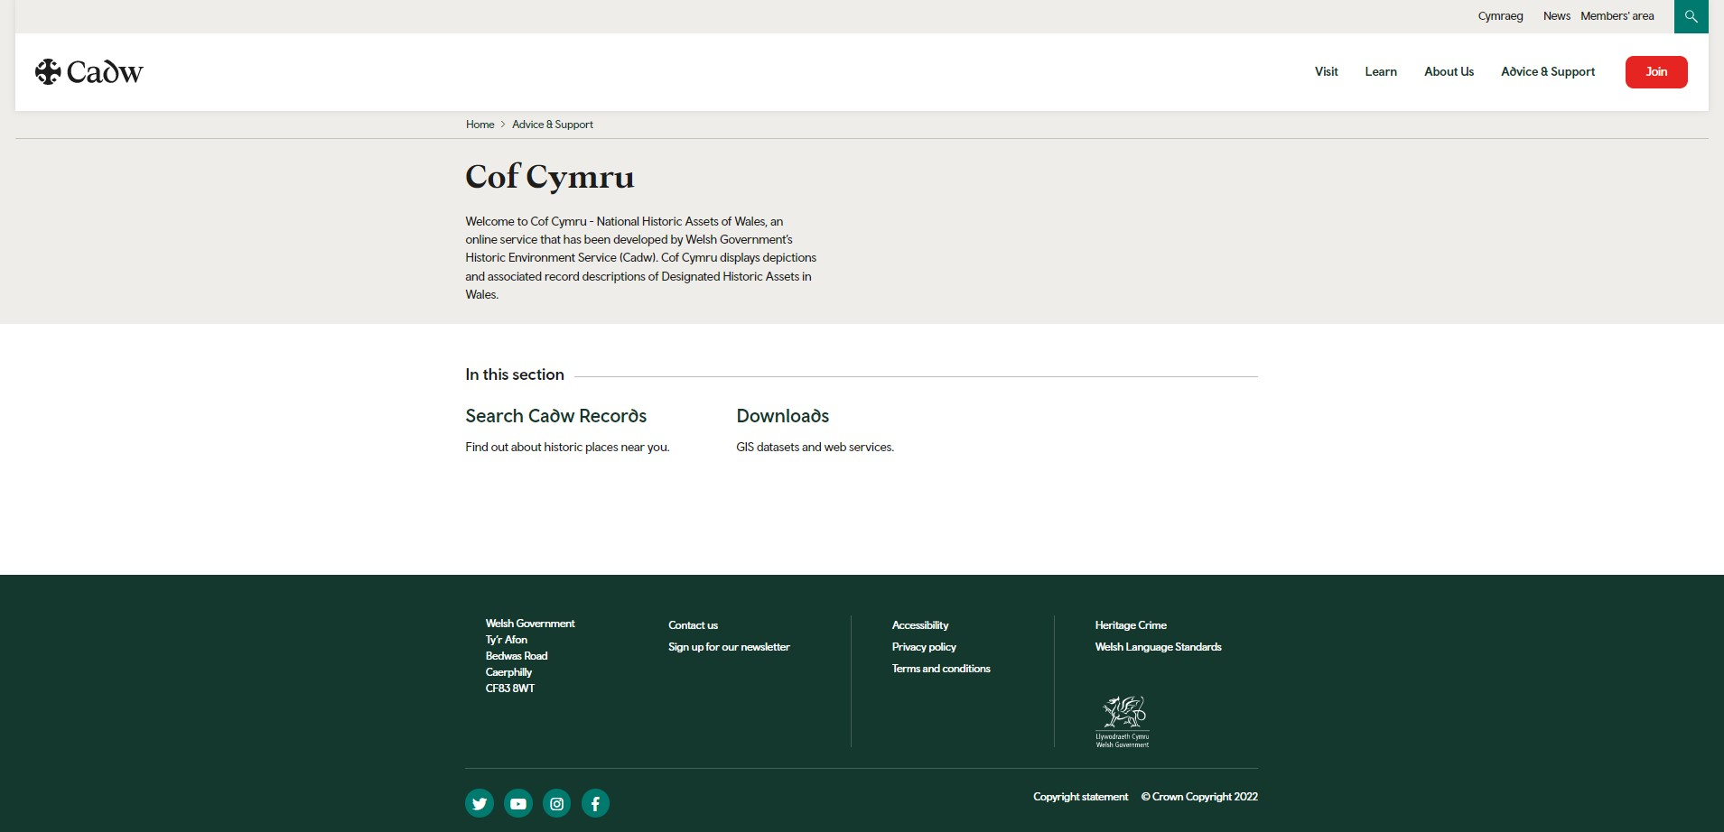
Cof Cymru
CBHC | RCAHMW
Cof Cymru is the online service portal that has been developed by Cadw and displays all of the data associated with designated historic assets. https://cadw.gov.wales/advice-support/cof-cymru

Slide 6
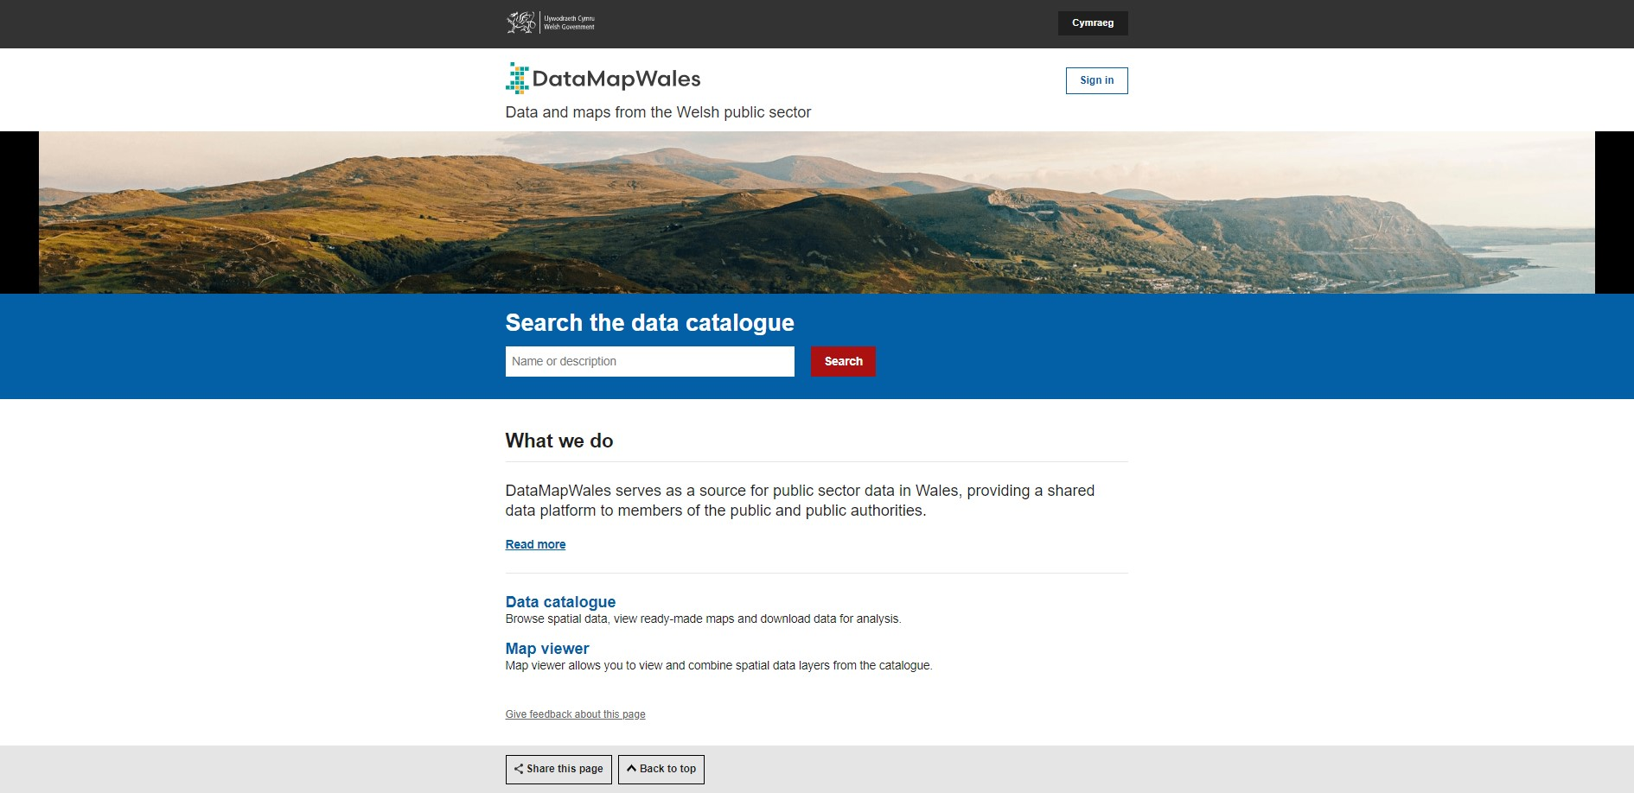
Data Map Wales
CBHC | RCAHMW
DataMapWales serves as a source for public sector data in Wales, providing a shared data platfrom to members of the public and public authorities.
You can view and download data including: Listed Buildings, Scheduled Monuments
https://datamap.gov.wales/

Slide 7
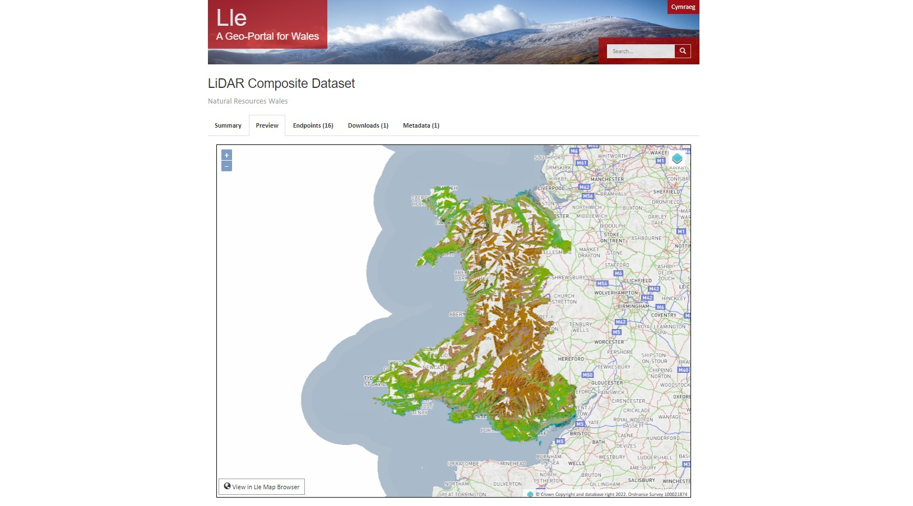
Lle & LiDAR
CBHC | RCAHMW
LiDAR for Wales can be found on DataMapWales, and its predecessor, Lle.
https://lle.gov.wales/catalogue/item/LidarCompositeDataset/?lang=en

Slide 8
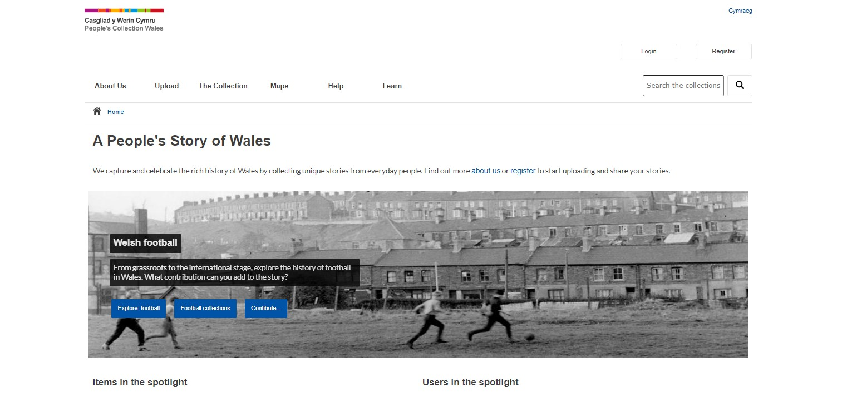
Peoples Collection of Wales
CBHC | RCAHMW
The Peoples Collection of Wales website is a free online resource dedicated to bringing together Wales’s heritage. This collection is full of documents, photographs, audio and video recordings, all of which relate to the history, culture and people of Wales. This has been complied by national organisations, but also local community groups and individuals.
https://www.peoplescollection.wales/

Slide 9
CBHC | RCAHMW
Archaeology at your Fingertips
Royal Commission on the Ancient
& Historical Monuments of
Wales

Slide 10
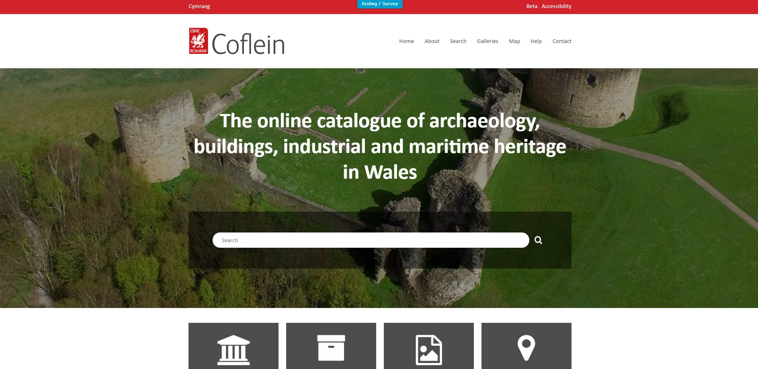
Coflien
CBHC | RCAHMW
Coflien is the online database for the National Monuments Record of Wales (NMRW) – The national collection of information about the historic environment of Wales, both terrestrial and maritime.
https://coflein.gov.uk/en/

Slide 11
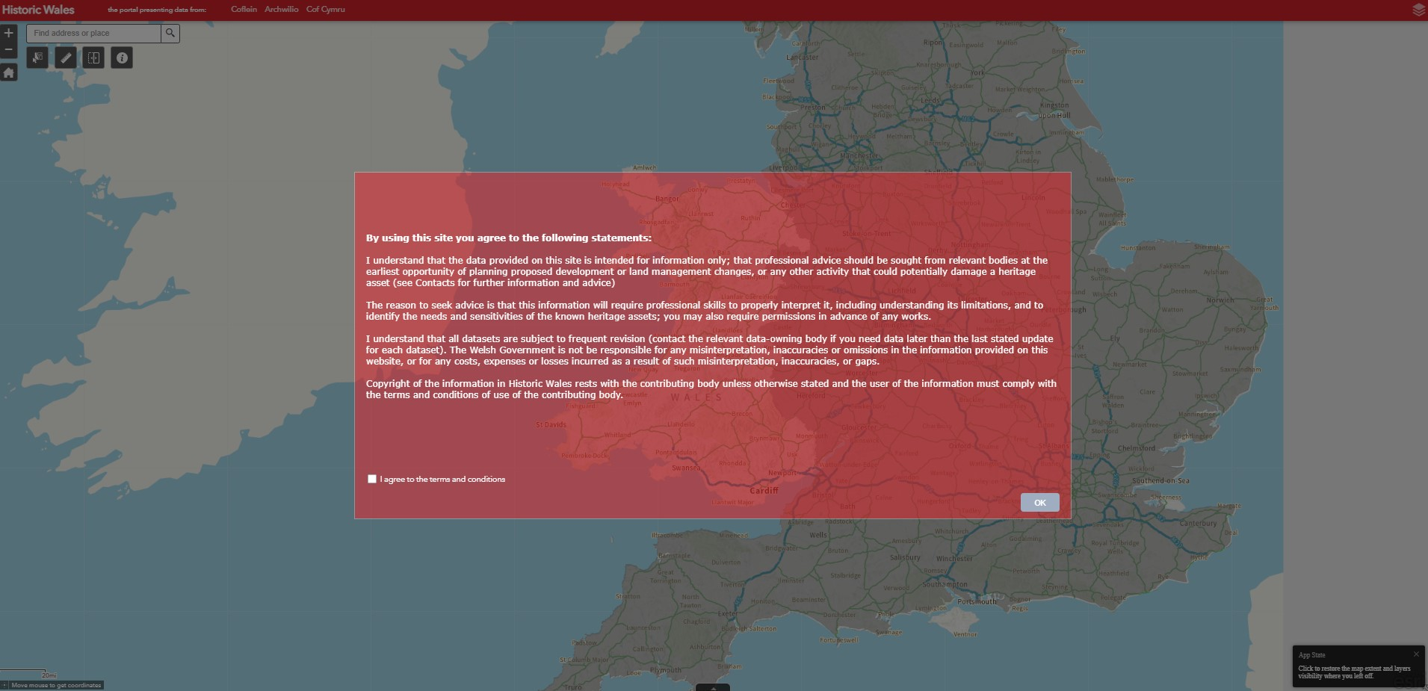
Historic Wales
CBHC | RCAHMW
Historic Wales is a map based web portal for all the historic environment information in Wales. You can search hundreds of thousands of records of Welsh Archaeology, buildings and artefacts.
https://historic-wales-rcahmw.hub.arcgis.com/

Slide 12
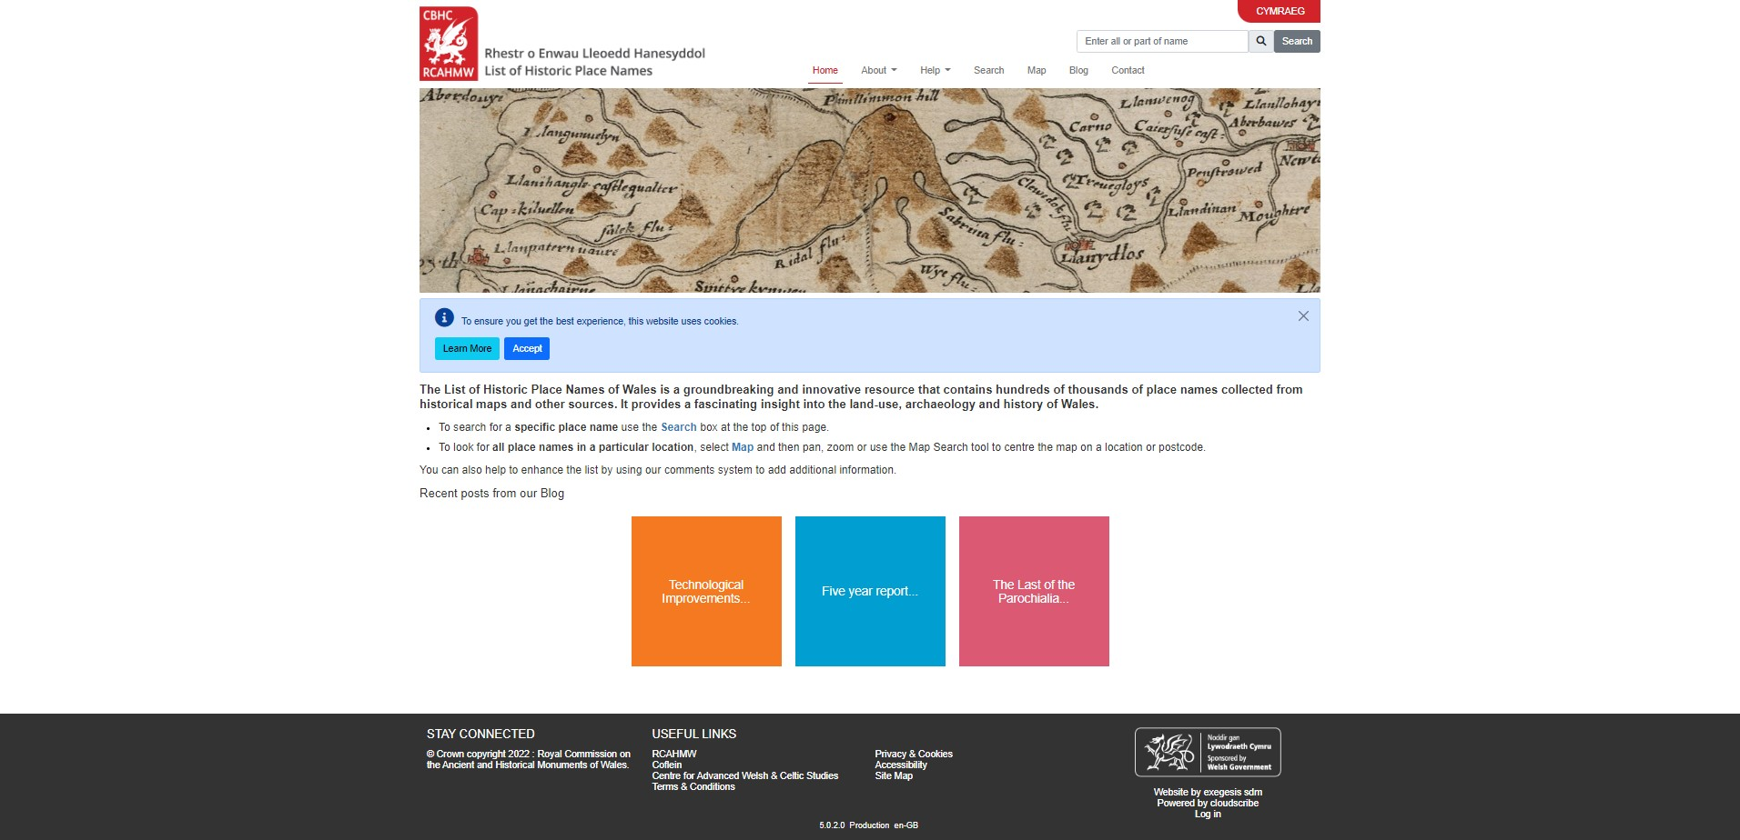
List of Historic Placenames
CBHC | RCAHMW
This website contains hundred of thousands of place names collected from historical maps and other sources. It provides a fascinating insight into the land-use, archaeology and history of Wales.
https://historicplacenames.rcahmw.gov.uk/

Slide 13
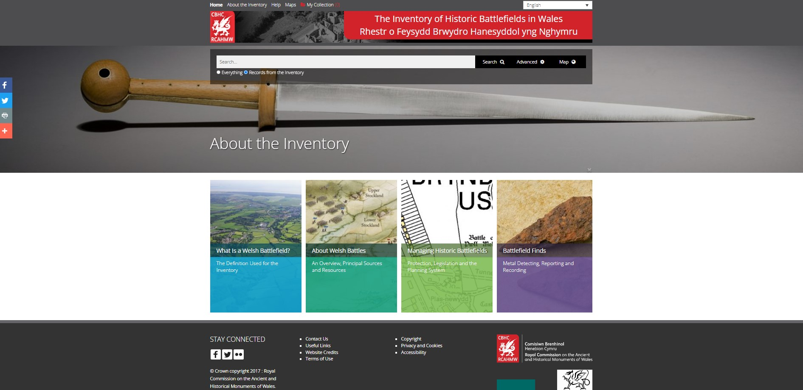
Inventory for Historic Battlefields
CBHC | RCAHMW
The Inventory of Historic Battlefields is Wales is an online database relating to battlefields and other sites of conflict within Wales. It contains over 700 sites based upon documentary sources, poetry and official records.
https://rcahmw.gov.uk/the-inventory-of-historic-battlefields-in-wales-2/

Slide 14
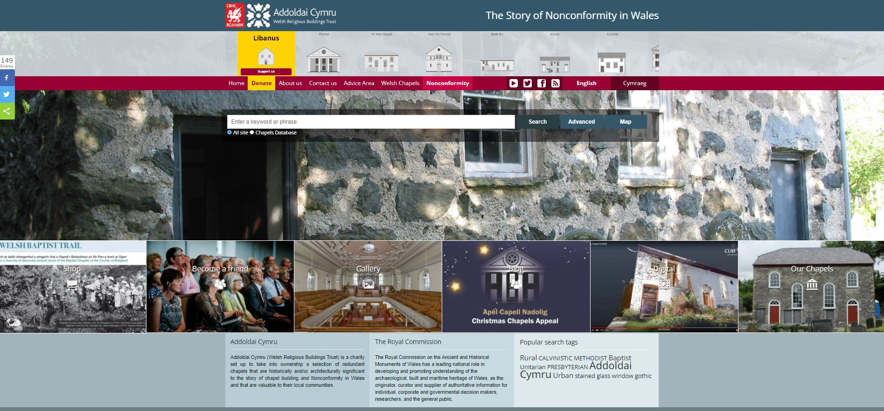
Welsh Chapels Database
CBHC | RCAHMW
This website and online database tells the national story of chapel building and non-conformity in Wales. This website contains a wealth of information about Welsh Chapels, their history and architecture.
https://welshchapels.wales/

Slide 15
CBHC | RCAHMW
Archaeology at your Fingertips
Archaeological Trusts

Slide 16
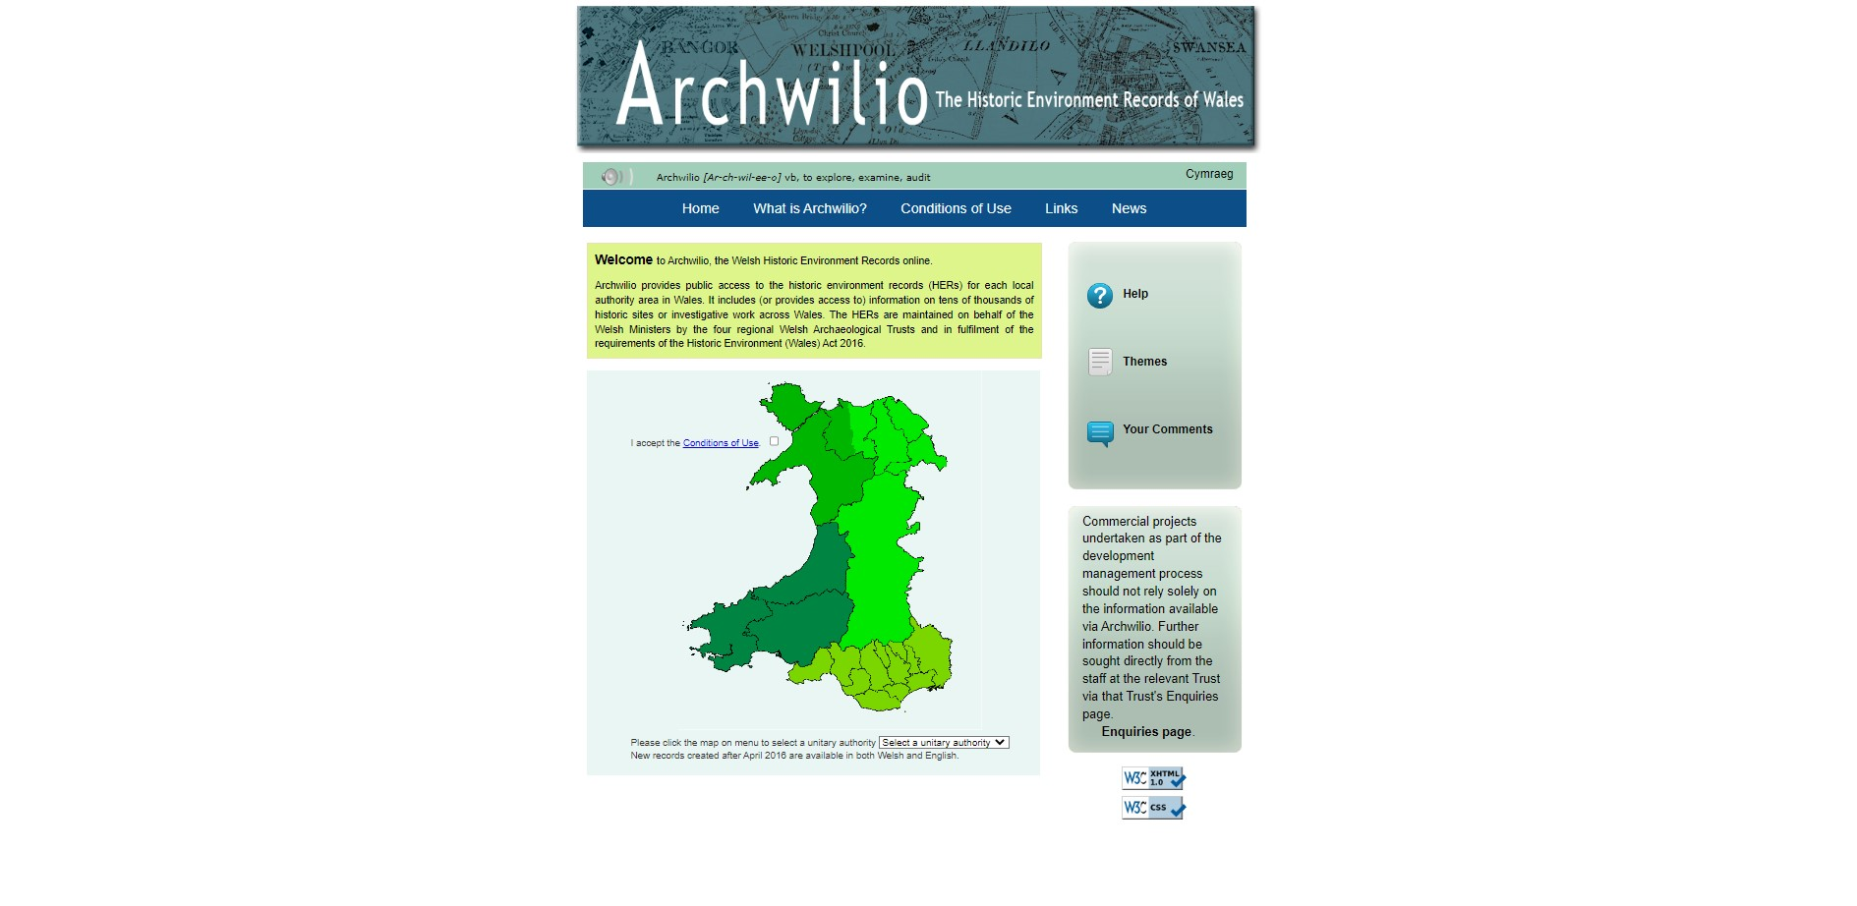
Archwilio – Regional Historic Environment Records
CBHC | RCAHMW
Archwilio provides public access to the historic environment records (HERs) for each local authority in Wales. It includes information relating to tens of thousands of historic sites which have been collated by each regional Archaeological Trust.
https://www.archwilio.org.uk/arch/

Slide 17
CBHC | RCAHMW
Archaeology at your Fingertips
National Museum of Wales

Slide 18
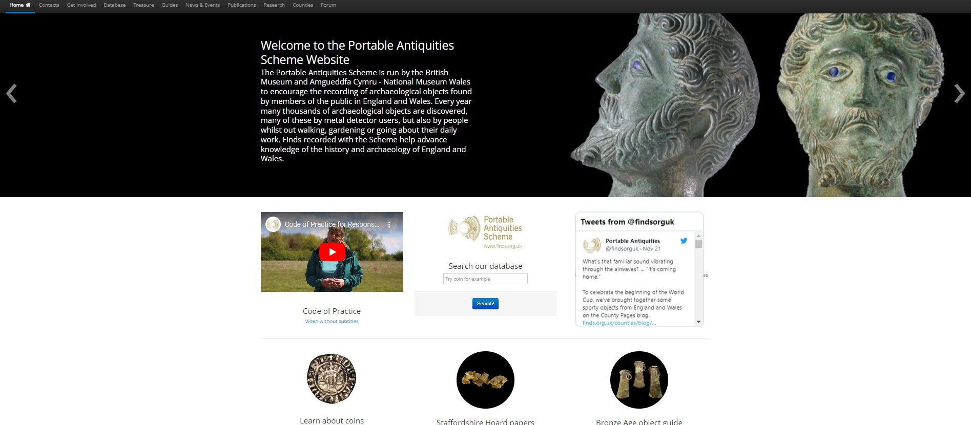
Portable Antiquities Scheme
CBHC | RCAHMW
The Portable Antiquities Scheme (PAS) encourages the reporting of archaeological artefacts and material under the Treasure Act of 1996. This material is often found by metal detectorists and other members of the public in England and Wales. In this website there is a link to the Online Database which is run by the British Museum & and National Library of Wales.
https://finds.org.uk/

Slide 19
CBHC | RCAHMW
Archaeology at your Fingertips
Wider UK

Slide 20
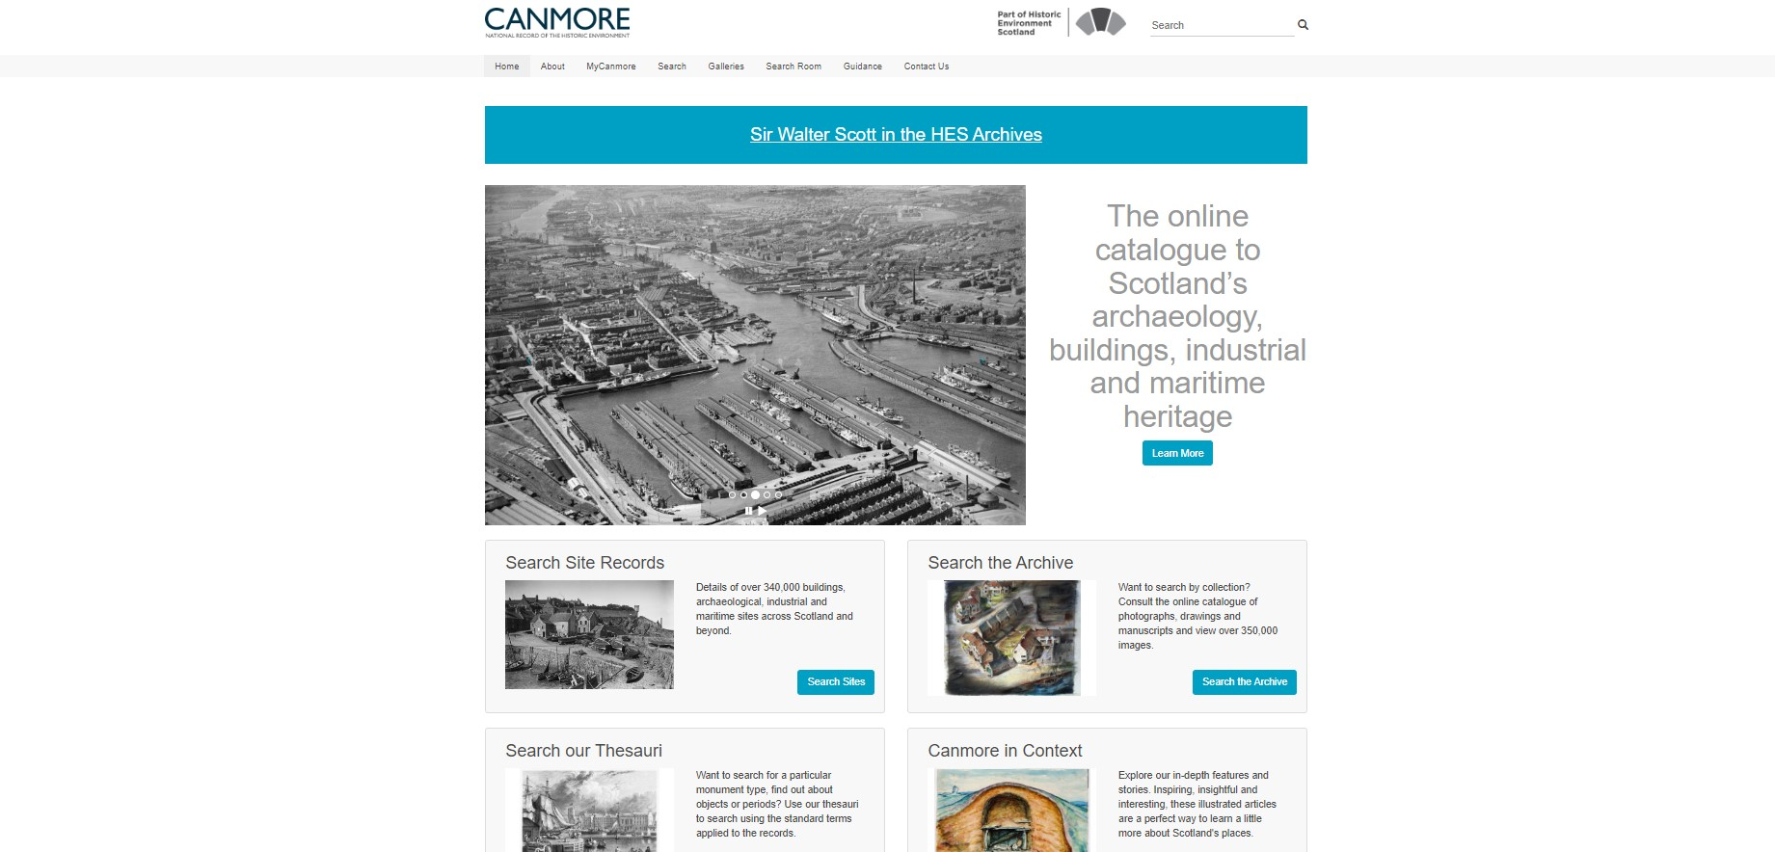
Scotland - Canmore
CBHC | RCAHMW
Canmore is the Scottish equivalent of the Coflien. It is the online catalogue to Scotland's Archaeology, buildings, industrial and maritime heritage.
https://canmore.org.uk/

Slide 21
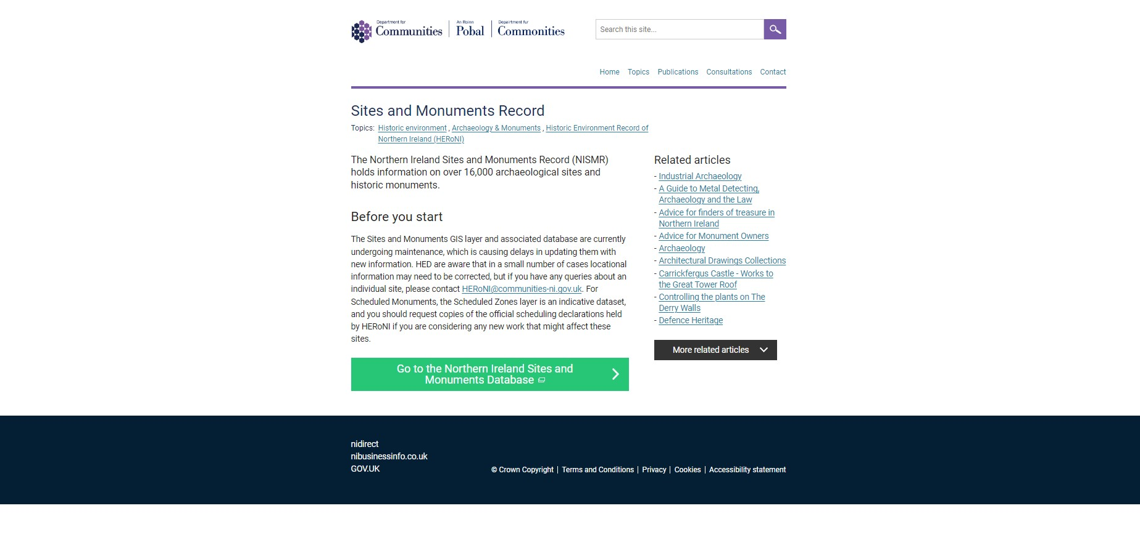
Northern Ireland Sites & Monuments Record
CBHC | RCAHMW
Northern Ireland Sites and Monuments Record is the Northern Irish equivalent to Coflien. It contains information relating to over 16,000 archaeological sites and historical monuments sited in Northern Ireland.
https://www.communities-ni.gov.uk/services/sites-and-monuments-record

Slide 22
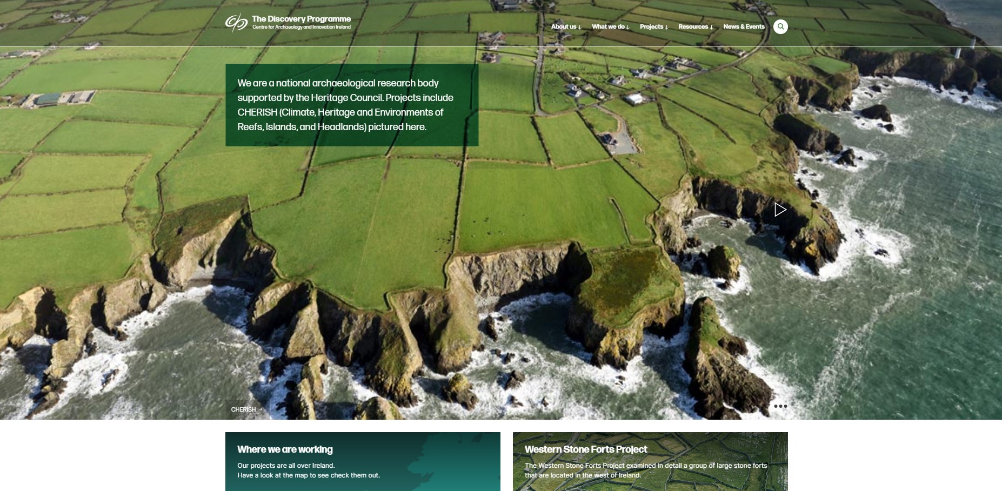
Discovery Programme Ireland
CBHC | RCAHMW
The Discovery Programme of Ireland are a national research organisation supported by the Heritage Council of Ireland.
https://discoveryprogramme.ie/

Slide 23
English HERs
CBHC | RCAHMW
To get access to the HERs in England, Historic England have created the Heritage Gateway portal. This website gives information and links to the various HERs in England, many of which are run by local council services.
https://www.heritagegateway.org.uk/gateway/

Slide 24
Archaeological Data Service
CBHC | RCAHMW
This is an accredited digital repository for heritage data within the UK. Established in the 1990’s, this repository curates a wealth of digital archaeological and historic environment data. It is currently managed by the University of York.
https://archaeologydataservice.ac.uk/

Slide 25
CBHC | RCAHMW
Archaeology at your Fingertips
Maps & Models

Slide 26
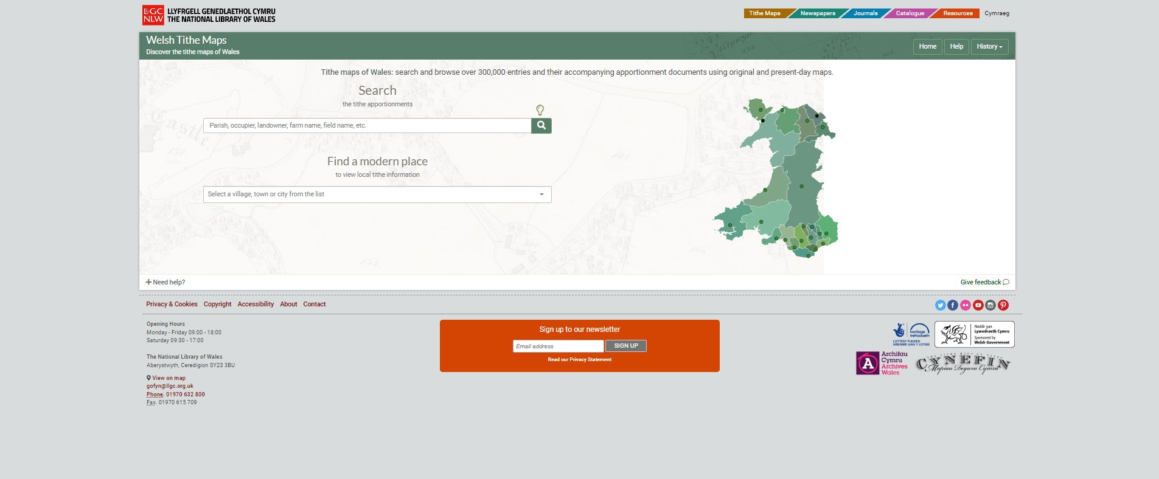
Places of Wales – Welsh Tithe Maps
CBHC | RCAHMW
The National Library of Wales undertook an extensive project to digitise all of their tithe map collections and make them publicly accessible. The Cynefin project saw public volunteers georeference and transcribe all of the tithe maps. These can now be accessed though the places of Wales website.
https://places.library.wales/

Slide 27
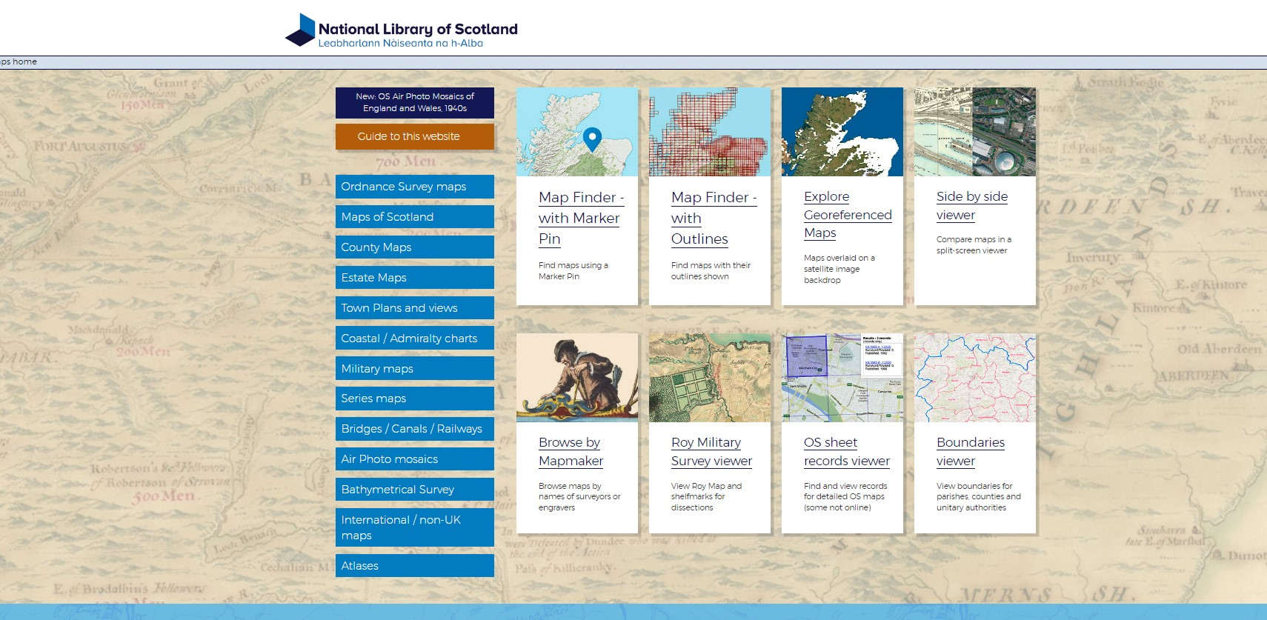
National Library of Scotland
CBHC | RCAHMW
The National Library of Scotland (NLS) has made a wealth of UK historic mapping available to the public, especially the Historic Ordnance Survey Collections.
https://maps.nls.uk/

Slide 28
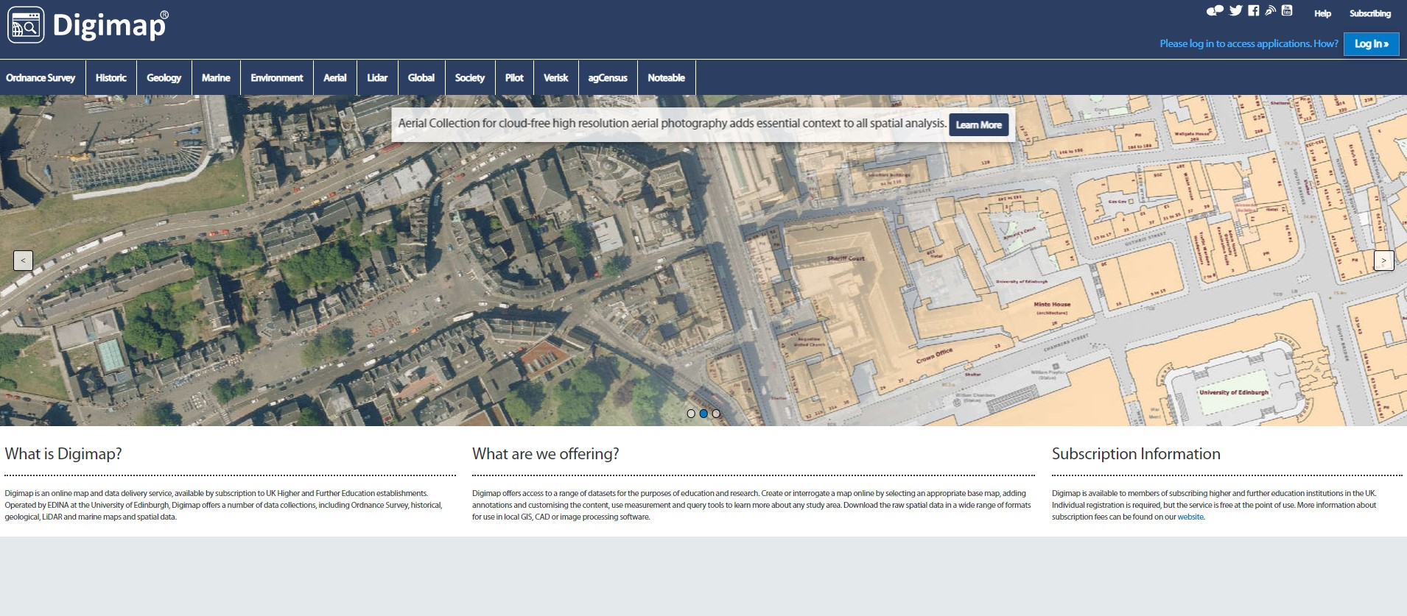
Digimap
CBHC | RCAHMW
Digimap is accessible to UK higher and further education establishments and contains maps from the Ordnance Survey, Geological maps, LiDAR and Maritime. https://digimap.edina.ac.uk/

Slide 29
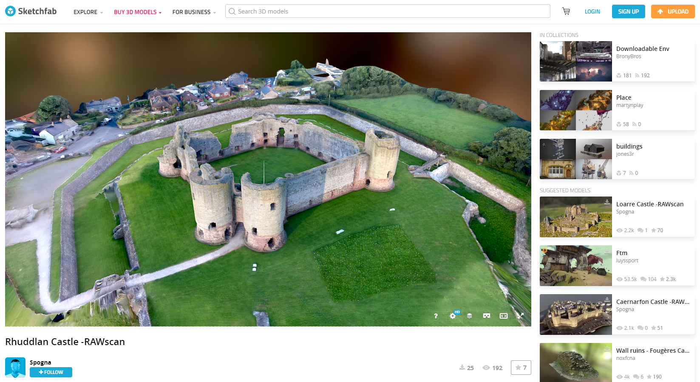
Sketchfab
CBHC | RCAHMW
Sketchfab allows people to view and distribute 3D Models and Augmented Reality experiences.
https://sketchfab.com/

Slide 30
CBHC | RCAHMW
Archaeology at your Fingertips
Glimpse of the Future

Slide 31
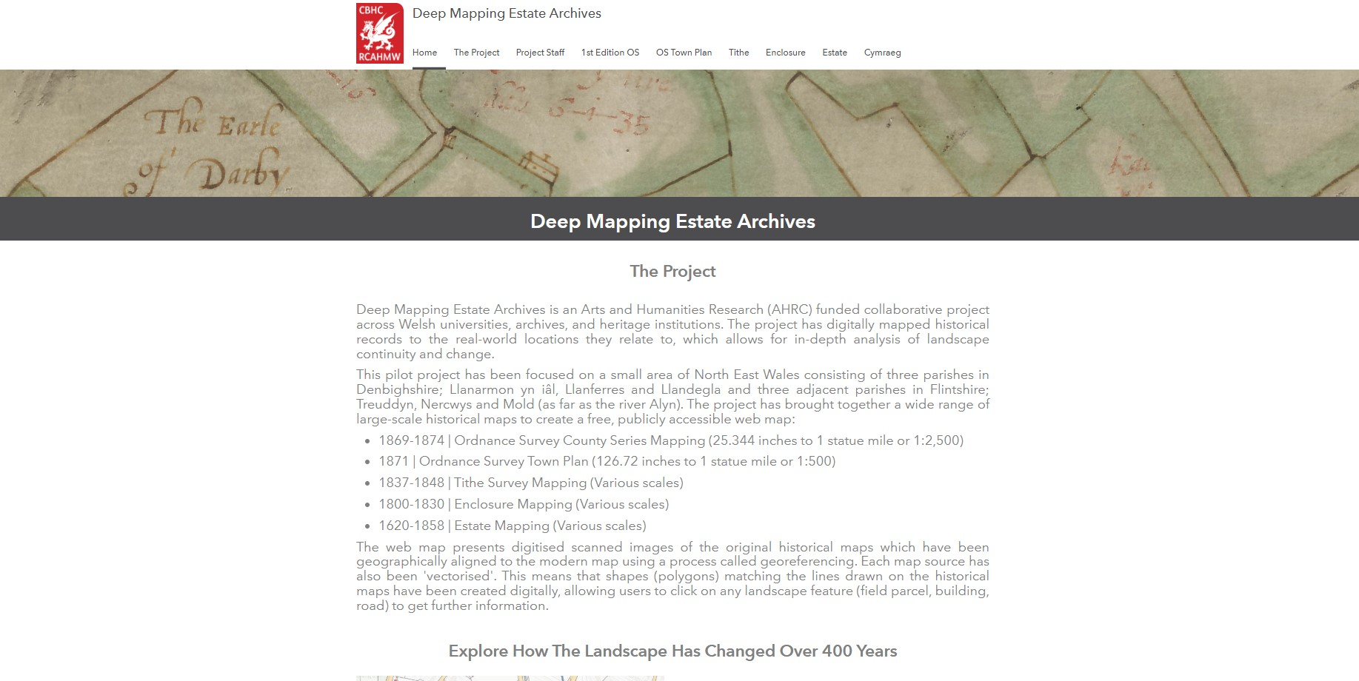
Deep Mapping Estate Archives
CBHC | RCAHMW
The ‘Deep Mapping Estate Archives’ project bring together a wealth of historical map information from the early 17th century to the present which is easy to visualise and interrogate.
https://deep-mapping-estate-archives-rcahmw.hub.arcgis.com/

Slide 32
Questions
CBHC | RCAHMW
Thank you for listening, I would like to take this opportunity to invite your questions.
Jon Dollery MA FRGS
Swyddog Mapio | Mapping Officer
jon.dollery@cbhc.gov.uk | jon.dollery@rcahmw.gov.uk

