Slide 1
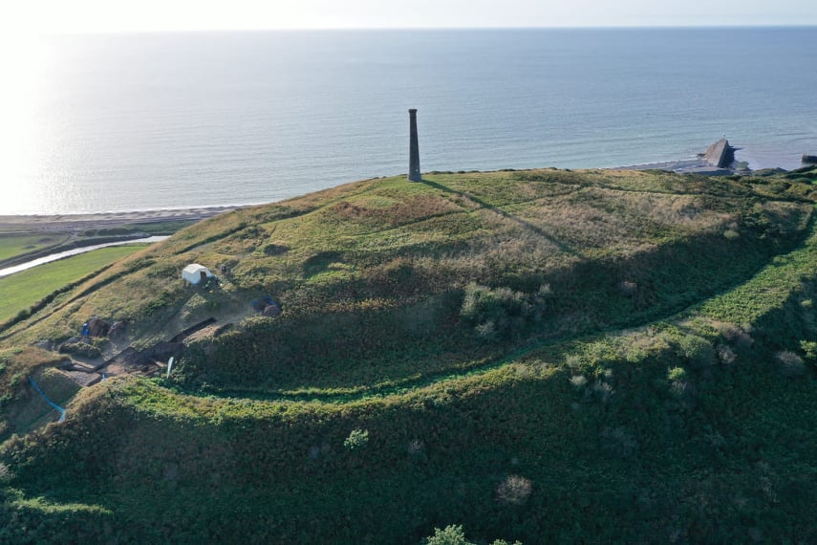
RECENT INVESTIGATIONS AT
PEN DINAS HILLFORT 2021
Notes:
In September of 2021 a 3 week community excavation was undertaken by Dyfed Archaeological Trust, grant-aid funded by Cadw
Ceredigion CCC – Nature Reserve
The excavation focussed on the southern entrance of the southern fort.
These excavations aimed to engage with the local community’s desire, as demonstrated by the work of the Penparcau Community Hub to raise the profile of the site
Alan Chamberlain
, to understand and appreciate the monument they see every day. As one volunteer put it ‘I look up at that hill every day from my kitchen window and always wonder who lived there and why’.
Pen Dinas is a multivallate Iron Age hillfort sitting high above the village of Penparcau on the outskirts of Aberystwyth, Ceredigion.
The hillfort is amongst the most impressive in Wales and is the largest in Ceredigion at approximately 3.6 hectares.
The fort is complex, consisting of a northern and southern fort that are thought to have been joined at a later date by a so-called ‘isthmus’.
The massive defences defending the fort are clearly visible and the sites of about a dozen prehistoric round houses can still be seen. These take the form of circular or D-shaped scoops, cut into the bedrock to provide a level platform for building. Several of these 'hut platforms' can be made out in the southern half of the south fort, clustered around the south gate.
Today the southern fort is a nature reserve owned by Ceredigion County Council and the northern fort is under pasture and privately owned. The whole site is a Scheduled Monument (reference no. CD 007).
In 2009, a feasibility study was commissioned by the Penparcau Community Hub and undertaken by Trysor Heritage (Sambrook and Hall xxx). This established that the hillfort was an under-utilized heritage resource and was suffering from vegetation change.
Subsequently, a geophysical survey was undertaken within the southern fort by Archaeology Wales to understand the preservation of sub-surface deposits (Poucher 2019).

Slide 2
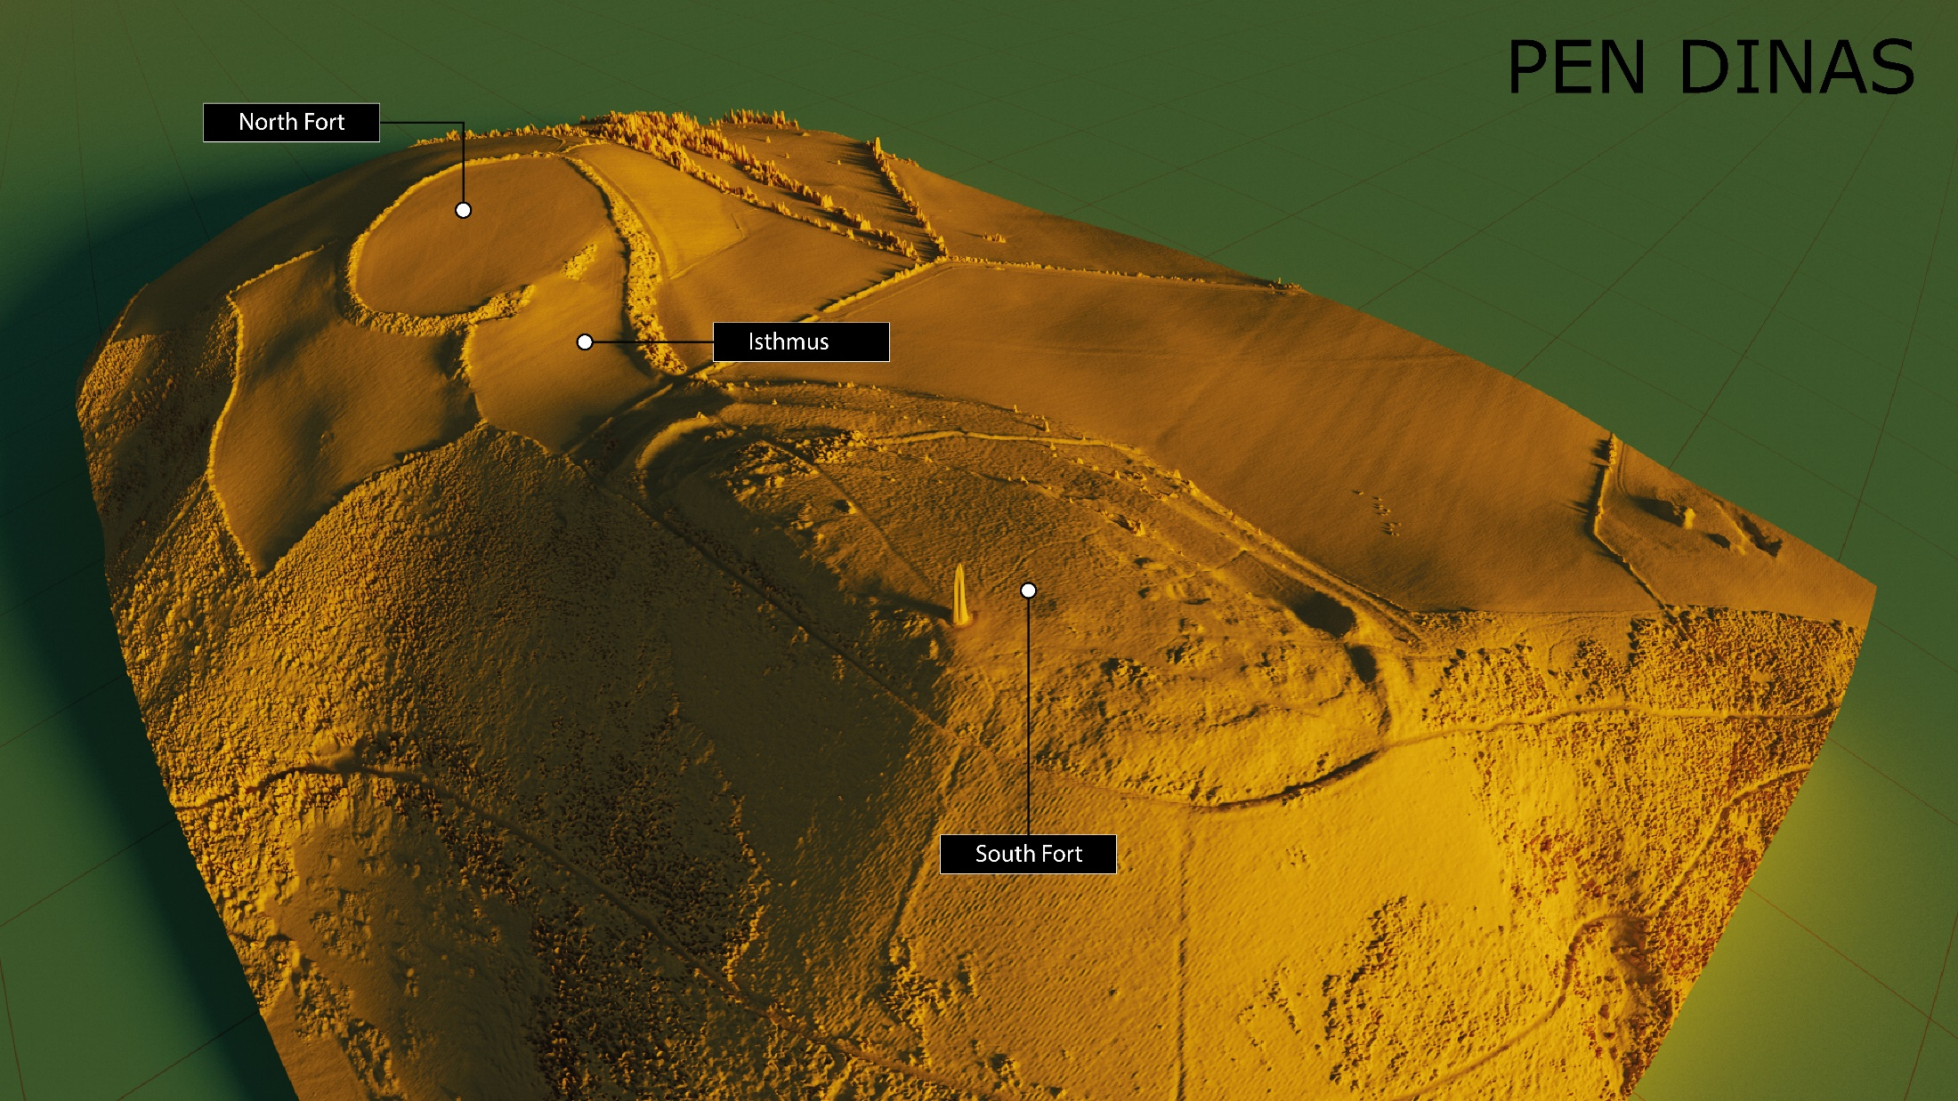
Notes:
Iron Age – 800-750 BC to AD 43 – Claudius
Typified by hillforts – large prominent enclosure defended by massive banks and ditches
By the end of the Iron Age many people lived in hill forts. The forts were surrounded by walls and ditches and warriors defended their people from enemy attacks.
Inside the hill forts, families lived in round houses. These were simple one-roomed homes with a pointed thatched roof and walls made from wattle and daub (a mixture of mud and twigs).
In the centre of a round house was a fire where meals were cooked in a cauldron. Around the walls were jars for storing food and beds made from straw covered with animal skins.
Iron Age farmers grew crops and vegetables. They kept geese, goats and pigs and had large herds of cows and flocks of sheep. Some people worked as potters, carpenters and metalworkers. Men and boys trained as warriors. They had to be prepared to fight at any time.
But that’s not the only settlements

Slide 3
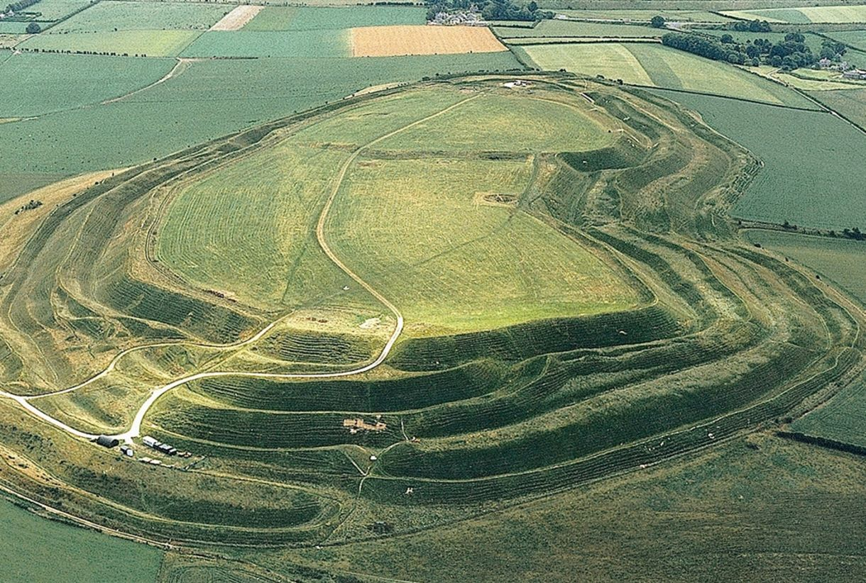
Notes:
Maiden Castle Dorest

Slide 4
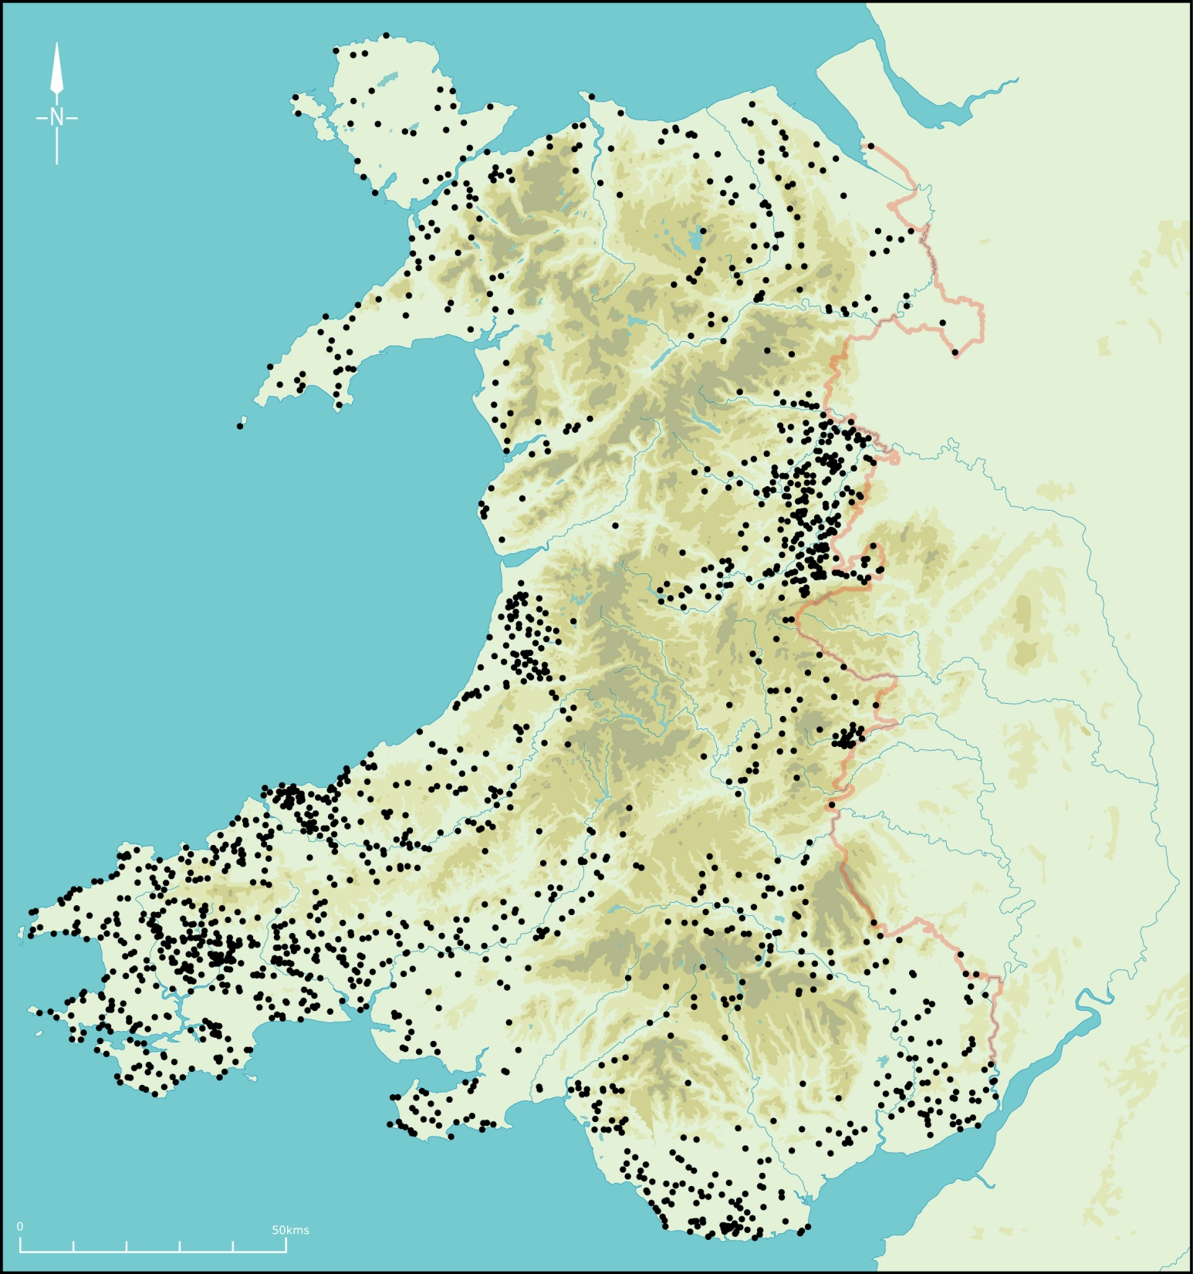
HILLFORTS AND OTHER ENCLOSED SETTLEMENTS IN WALES
Notes:
Here’s the distribution of all sites in Wales. Note the general lowland distribution. Some clusters due to aerial photographic discoveries, such as the upper Severn valley.

Slide 5
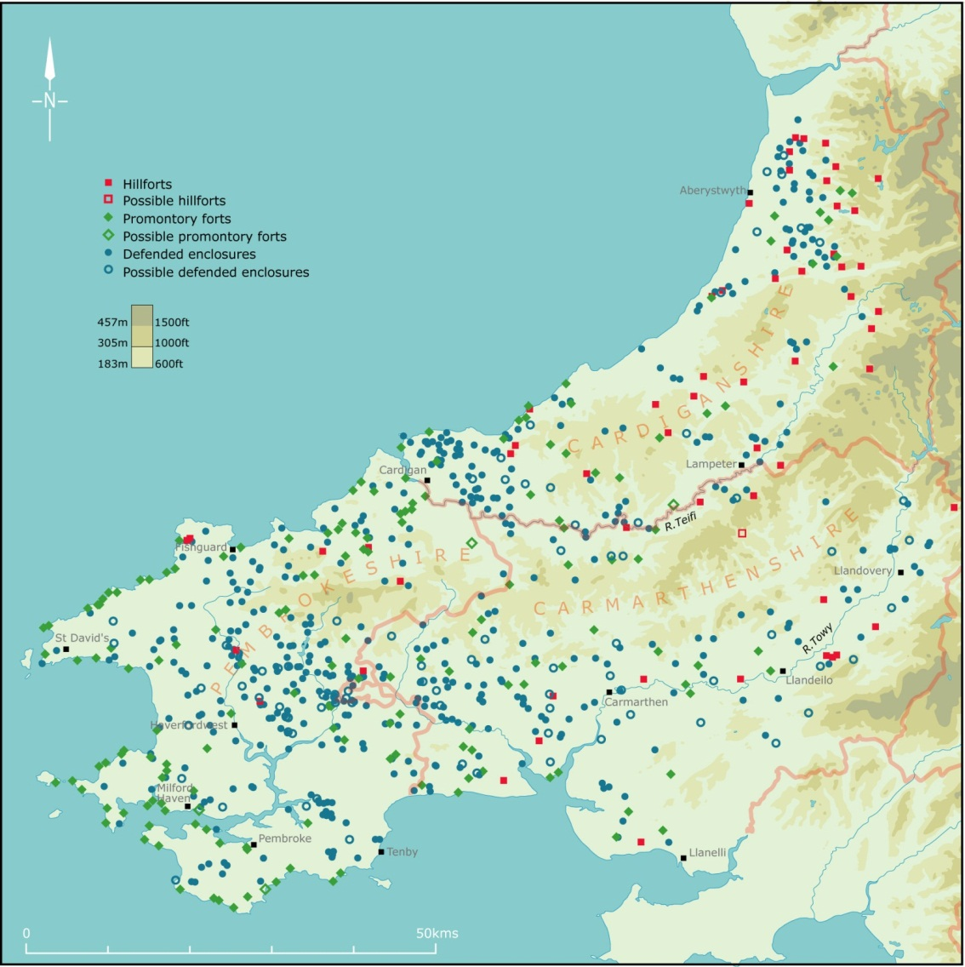
WEST WALES
HILLFORTS, PROMONTORY FORTS AND OTHER ENCLOSED SETTLEMENTS
Notes:
Western Wales falls into the a broadly Iron Age Atlantic zone extending from northern Scotland to northwest Spain characterised by large number of small settlements and a paucity of material culture. I’m not suggesting this is an indication of cultural contact, as the differences between these areas is often more striking than their similarities. However, small settlements surrounded by earth banks and ditches or by stone walls became the main settlement type across the Atlantic zone in the latter part of the first millennium BC, and for much of Wales they represent the main, and it could be argued the only, body of evidence for human activity in this period.
The paucity of Iron Age artefacts in the Atlantic zone seriously hampers Iron Age studies – this problem is particularly acute in west Wales.
In west Wales burials are rare. Pottery is absent from the end of the Early Bronze Age when the tradition of burying the dead with urns came to an end in about 1500 BC to the coming of the Anglo-Normans in AD 1100. Bone does not survive in the acid soils and other types of artefact, such as beads, brooches and iron objects tend to appear only towards the end of the period, and even then they are not common. An exception is during the Roman Period, when imported pottery, beads and bronze objects are brought in with the military conquest.

Slide 6
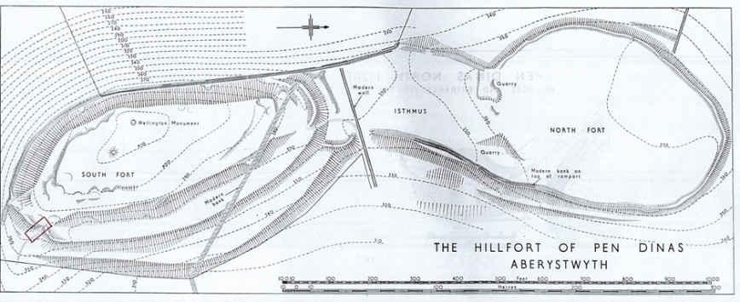
Most of what we know about Pen Dinas was learnt during excavations carried out between 1933-7 by Professor Daryll Forde. The excavations were written up in the 1960s by Griffiths, Hogg and Houlder of the RCAHMW in 1963.
Notes:
Professor Daryll Forde was an anthropologist from Aberystwyth University. A series of interim reports detailing these excavations were produced in the Bulletin of British Celtic Studies (xxx), but no full excavation publication was produced.
Consequently, the results of the excavations and a new topographical study (Figure 2) were produced by the Royal Commission for Ancient and Historical Monuments of Wales in the 1960’s after receiving the archive and consultation with Forde (Hogg et al. 1963).
A four-part chronology for the site was established.
And one of our aims was to assess the validity of this chronology.
Whilst not necessarily wrong it was established based on an interesting approach to excavation whereby there was no formal stratigraphical relationship between the different areas or scientific dating techniques.
The archive is stored with the Royal Commission and it contains some wonderful photos and plans and is in itself a wonderful record of the period.

Slide 7
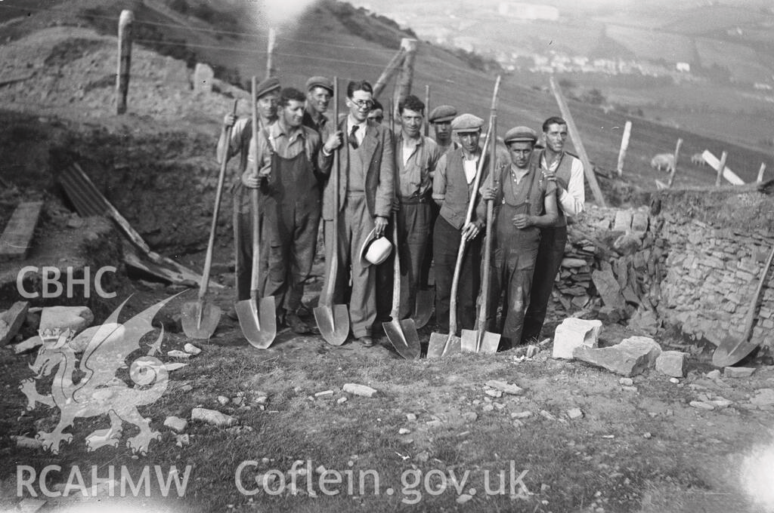

Slide 8
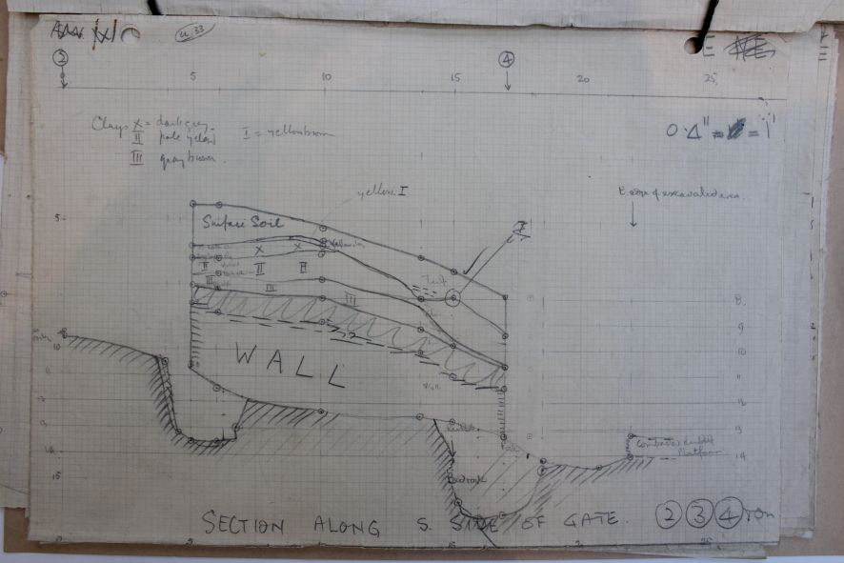

Slide 9
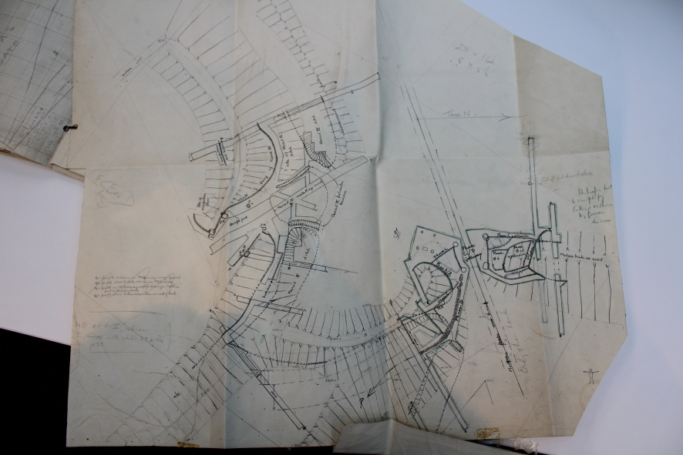

Slide 10
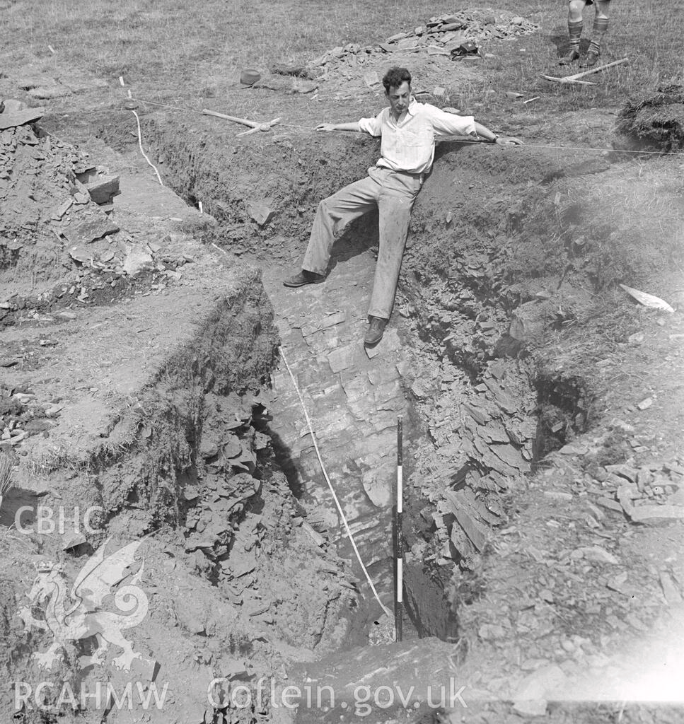
Notes:
View of the North Fort at Pen Dinas, Aberystwyth taken in early 1930's

Slide 11
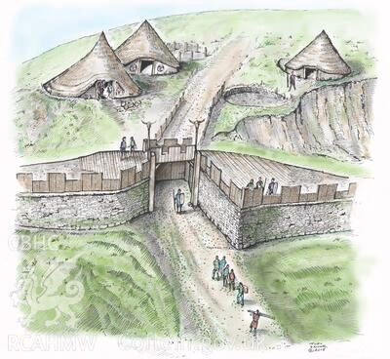
Notes:
Toby Drives reconstruction

Slide 12
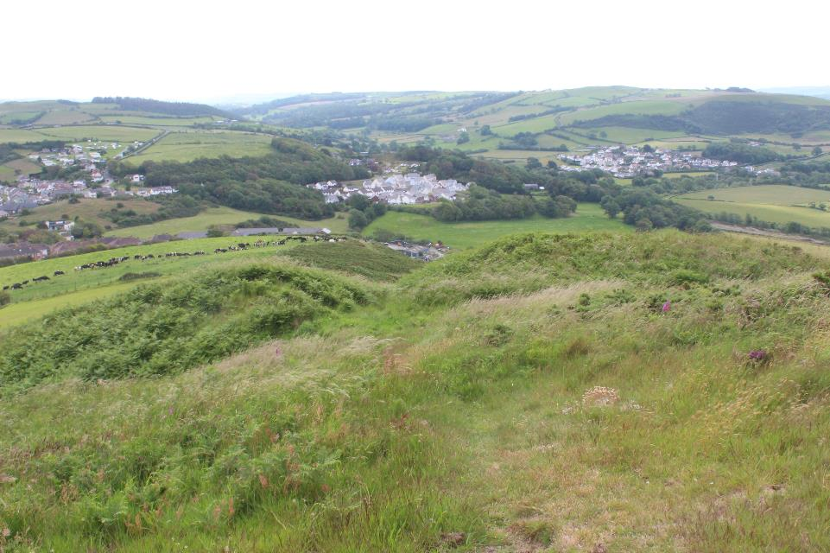
Notes:
We intended in 2021 to open two trenches within the area of the 1930s excavation, one in the southern entrance to the hillfort and another in a rock cut hut platform) immediately north of the entrance that we thought had also been excavated in the 1930s.
And we were not sure how much they had backfilled or not

Slide 13
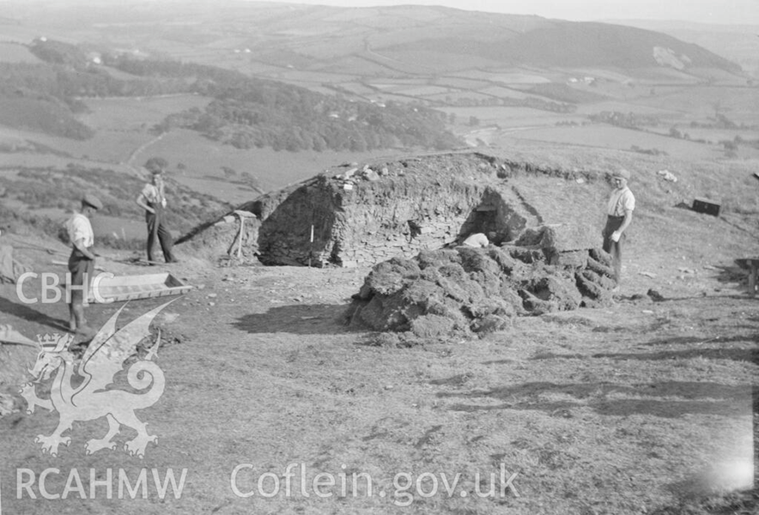
Notes:
Note well preserved stone revetment walls
Within the archive at the RCAHMW are photographs showing the stone revetment walls of the southern entrance but that wasn’t where they had stopped digging and we think that they investigated much further by removing most of the walls and digging below to some depth.
Upon excavation it was clear that much more of the defences had been removed than that described in the reporting of the site or the photographs of the excavation.
It is thought likely that the majority of the photograph’s were from a single visit by a photographer in the mid-part of the excavation
Unfortunately, they did not record this work in any drawings and we soon realised that to remove all the backfill would take up much of the available 3 weeks with not much result.

Slide 14
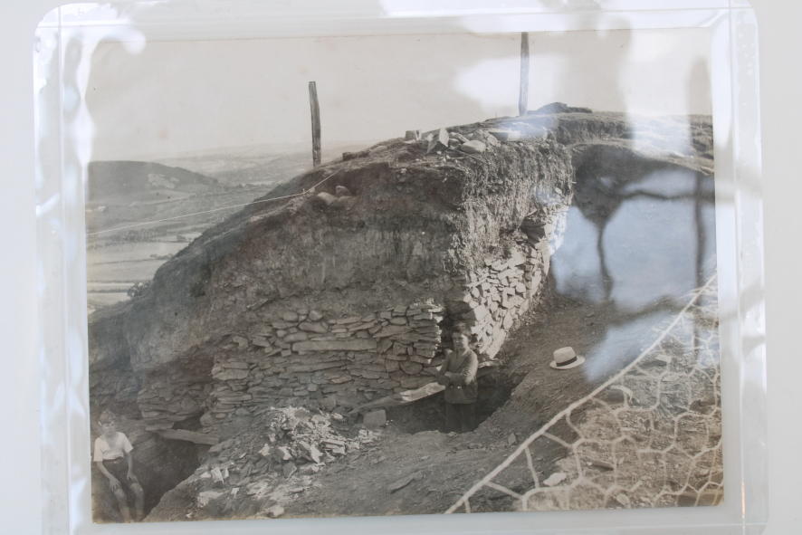
Notes:
Within the archive at the RCAHMW are photographs showing the stone revetment walls of the southern entrance but that wasn’t where they had stopped digging and we think that they investigated much further by removing most of the walls and digging below to some depth.
Upon excavation it was clear that much more of the defences had been removed than that described in the reporting of the site or the photographs of the excavation.
It is thought likely that the majority of the photograph’s were from a single visit by a photographer in the mid-part of the excavation
Unfortunately, they did not record this work in any drawings and we soon realised that to remove all the backfill would take up much of the available 3 weeks with not much result.
.

Slide 15
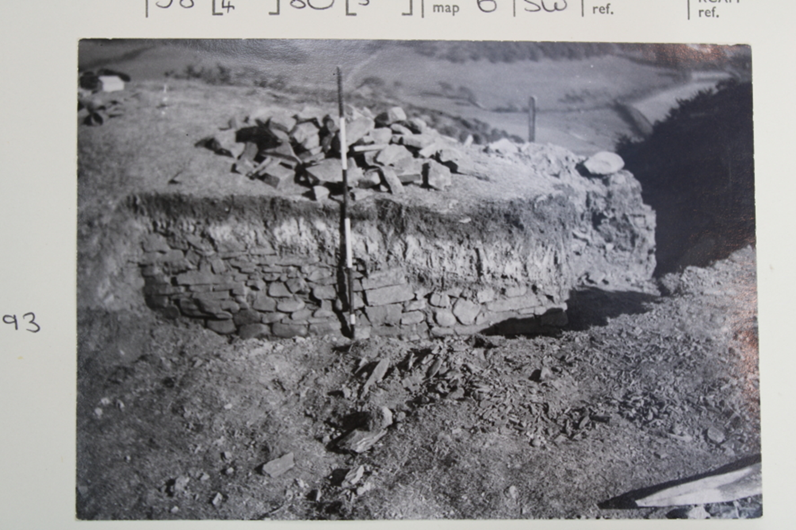
Notes:
However, we revealed one small area of north-facing revetment wall on the eastern terminus of the rampart bank and this was drawn in 1933 and it gives us a reference point to link this year’s findings to the 1930s work, as we know its spatial relationship with the rest of the entrance as recorded in 1933. If I can locate the bottom of the original bank even if in a small area and find a buried soil we could sample for C14.
where excavation subsequently focused.

Slide 16
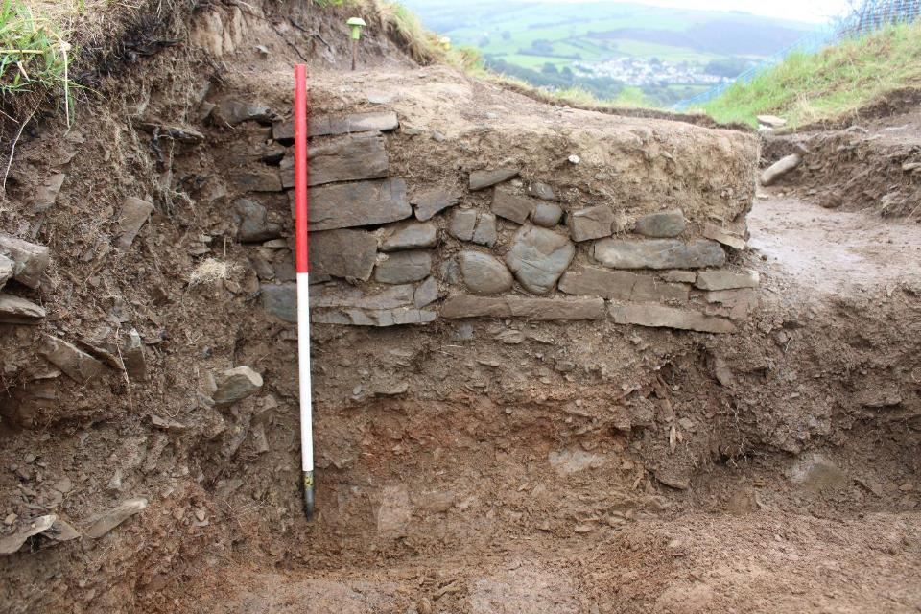
Stone within entrance from collapsed revetment walls
Notes:
Now we had a point of reference to join our work to Darryl Fordes’
And we thought why not expand upon this into the fort and connect with the trench through Platform A upslope to the N

Slide 17
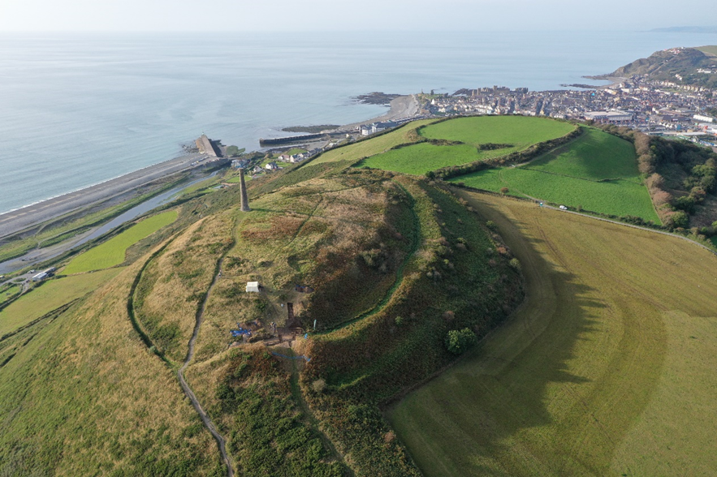
Notes:
Unfortunately, they never produced an overall plan of their excavations, so we were guessing to some extent. We had tried to align the 1930s photographs of the excavated hut platform with existing field boundaries we could see in the photographs and thought it was the one immediately north of the entrance but we got it wrong.
What we will have at the end of the excavation W-facing running section through the excavated platform , across the tumbled stone from the revetment walls, through the 1930s trench and up over the rampart. It will also catch the small section of in-situ revetment wall that has survived. We might be able to add in some detail from the 1930s drawings to it.
What is amazing is that between the southern entrance and hut platform A was another rock cut platform (much smaller than A) that we had no evidence for on the surface.
Cadw’s agreement

Slide 18
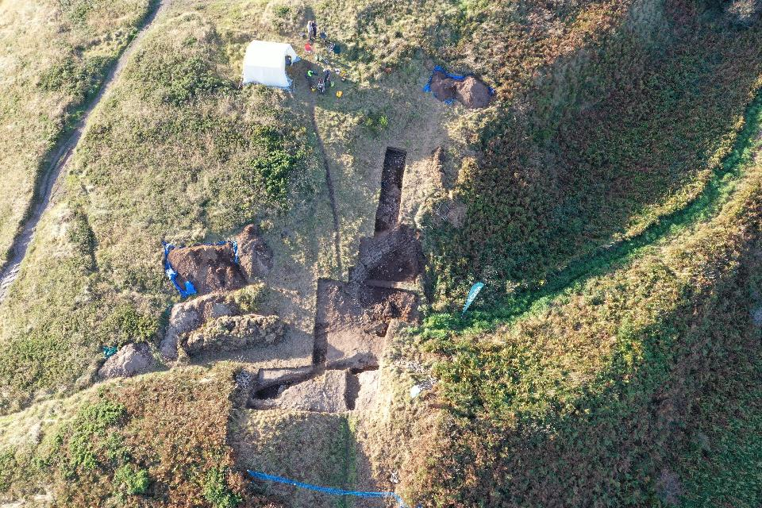

Slide 19
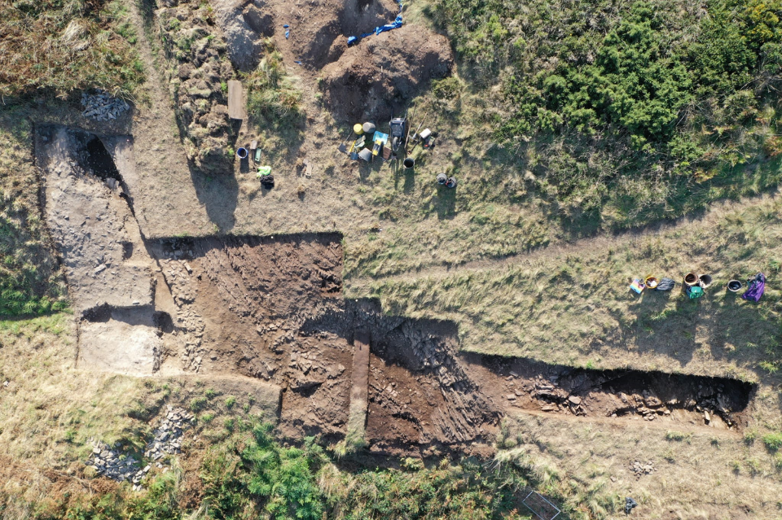
Notes:
Unfortunately, they never produced an overall plan of their excavations, so we were guessing to some extent. We had tried to align the 1930s photographs of the excavated hut platform with existing field boundaries we could see in the photographs and thought it was the one immediately north of the entrance but we got it wrong.
What we will have at the end of the excavation W-facing running section through the excavated platform , across the tumbled stone from the revetment walls, through the 1930s trench and up over the rampart. It will also catch the small section of in-situ revetment wall that has survived. We might be able to add in some detail from the 1930s drawings to it.
What is amazing is that between the southern entrance and hut platform A was another rock cut platform (much smaller than A) that we had no evidence for on the surface.
Cadw’s agreement

Slide 20
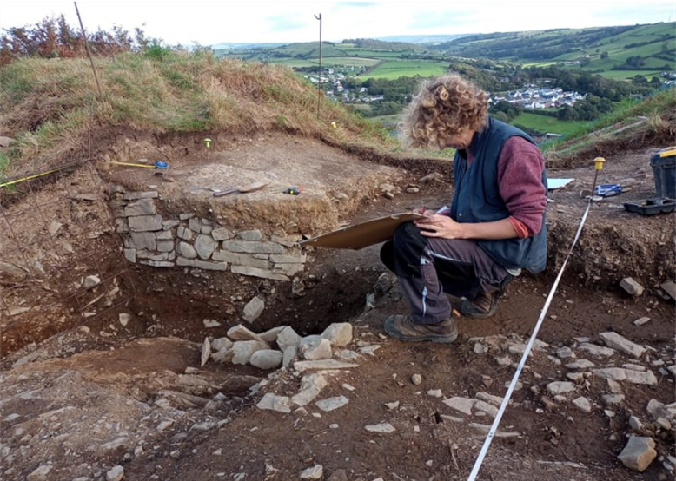
Recording the southern defences.
Notes:
This was the area immediately to the east of the gateway where two distinct phases of construction were identifiable. The earlier phase was represented by a large posthole and coarse layer of yellowish silty rubble with frequent charcoal inclusions directly overlying bedrock.
The large posthole [1034] was partially excavated in the 1930’s (PH3) (Photograph 11). However, the northern part of the posthole had fallen outside of their trench area and thus remained un-excavated allowing for reinterpretation (Photograph 12). The posthole was filled with large upright angular stones interspersed with a brownish silt (1033).
Posthole [1034] was overlain by rubble deposit (1036) not described in Forde’s accounts, this is thought to be a slumped earlier phase of defences (Photograph 13). (1036) was cut by the 1930’s excavation trench [1022] before being clearly visible continuing under the later revetment walling [1026].
A re-interpretation of posthole [1034] and rubble deposit (1036) being associated with an earlier phase is now preferred. It is likely that this earlier phase of defences is associated with the same phase of building defined by Forde as Phase II, where a buried revetment wall was seen on the western side of the gateway

Slide 21
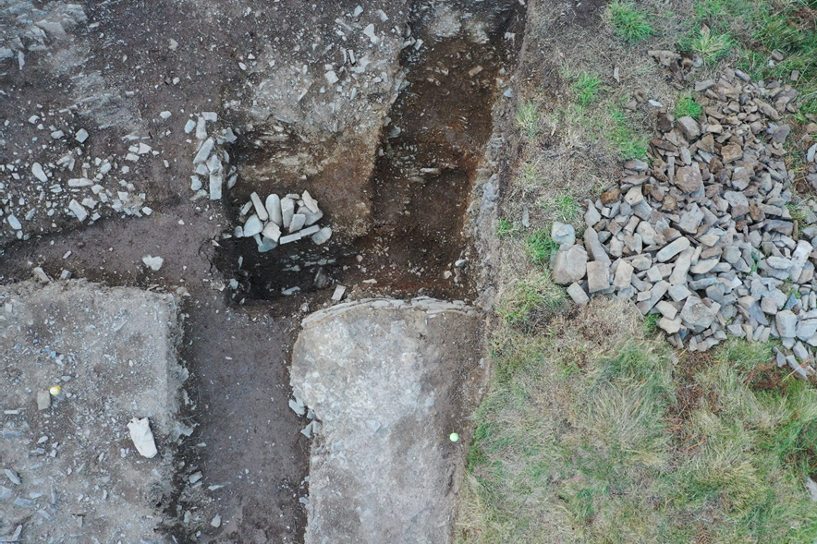
Aerial photograph showing posthole [1034] cut by 1930’s excavation trench

Slide 22
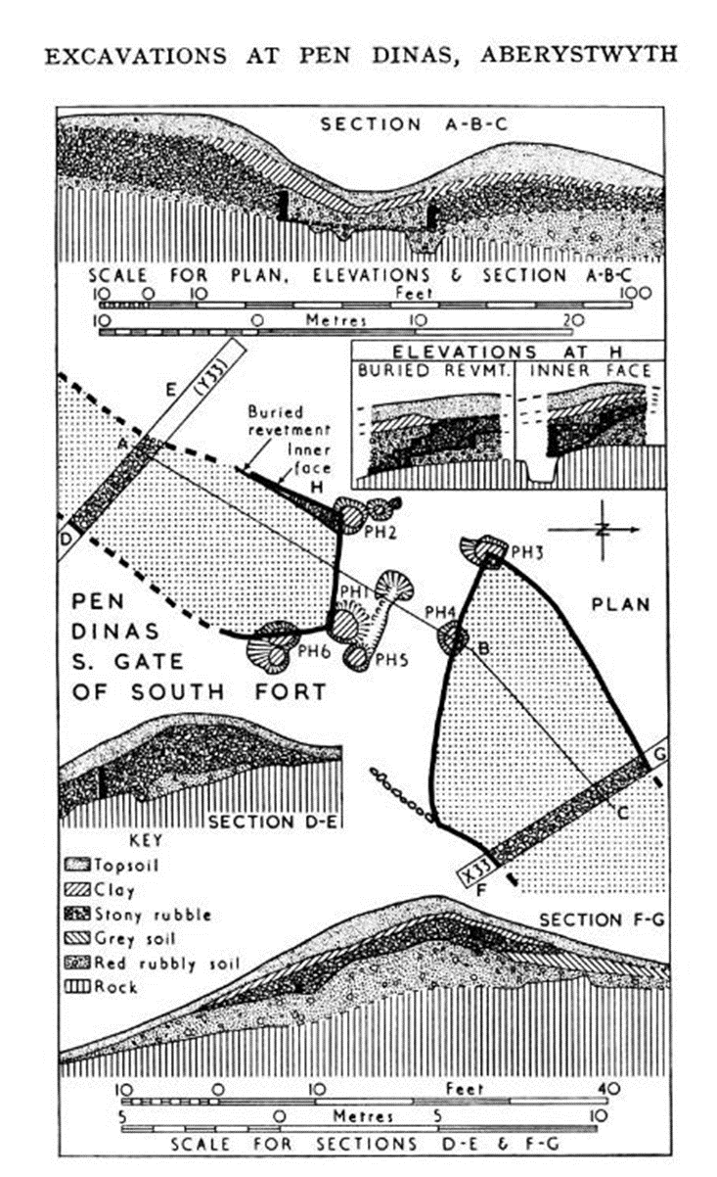

Slide 23
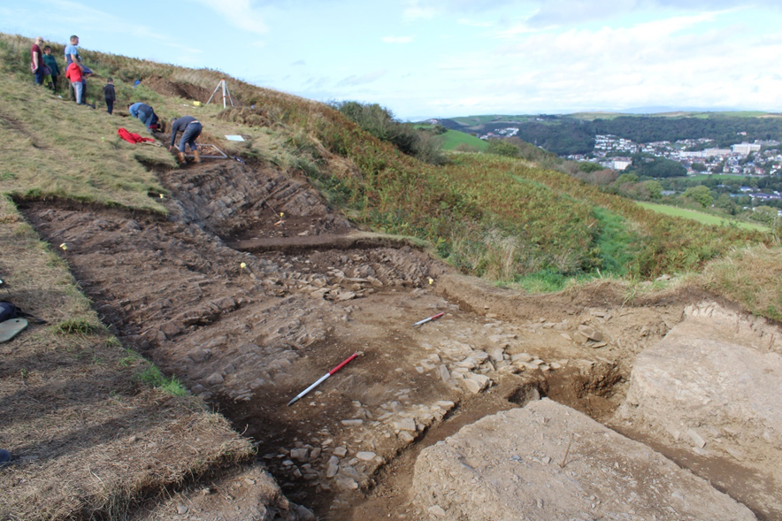
Metalled surface (1021)

Slide 24
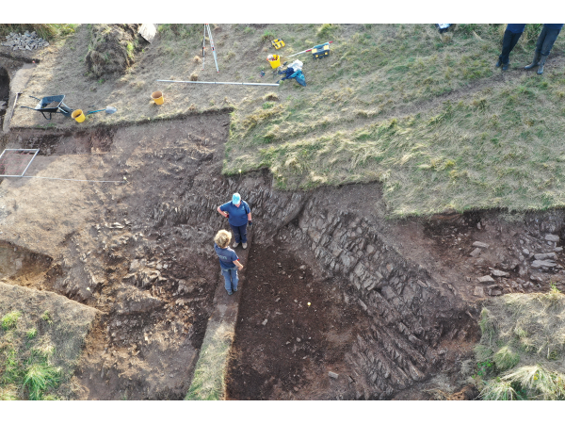
Middle rock cut hut platform

Slide 25
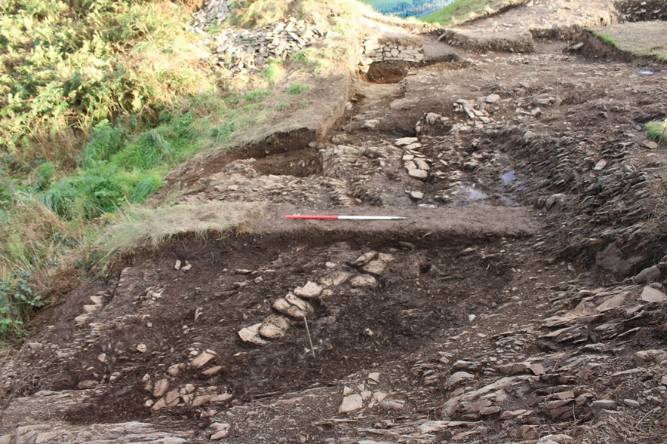
Stone capped drain (1038)

Slide 26
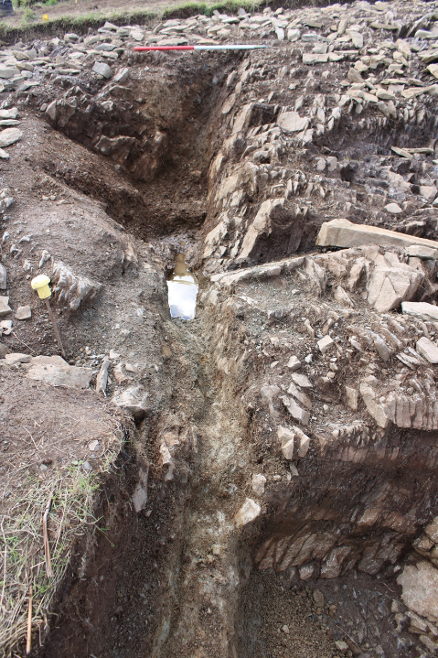
Showing drain [1038] with stone lined drain [1020] emptying from right. Looking southwest, 1m scale.
Notes:
Showing drain [1038] with stone lined drain [1020] emptying from right. Looking southwest, 1m scale.

Slide 27
Rock cut pit
Notes:
Just under the topsoil – so hardly any surface surviving.
Features filled with crushed bedrock and silt – and this is something we find on other sites of this age or older that the rab degrades and covers everything in a layer or rab

Slide 28
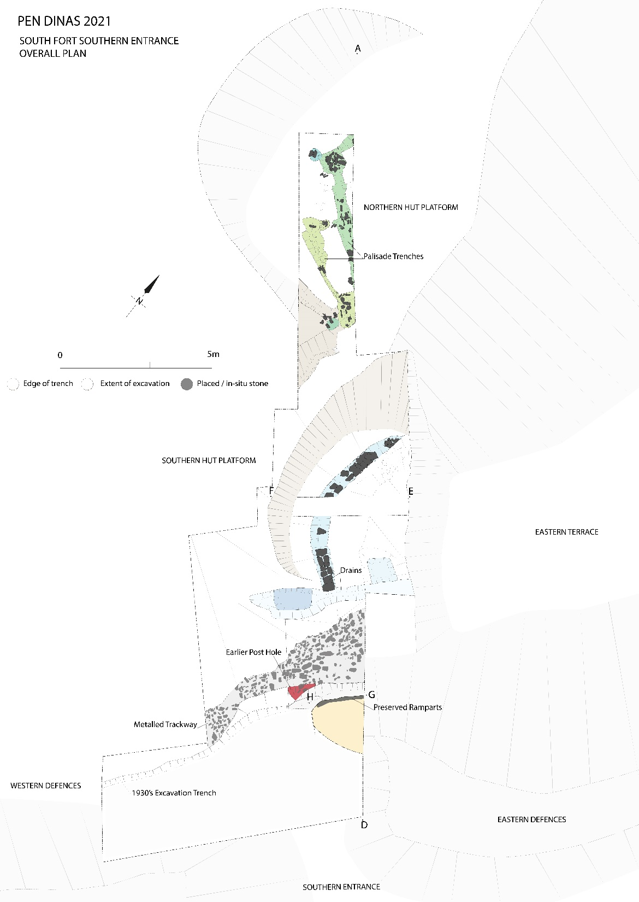

Slide 29
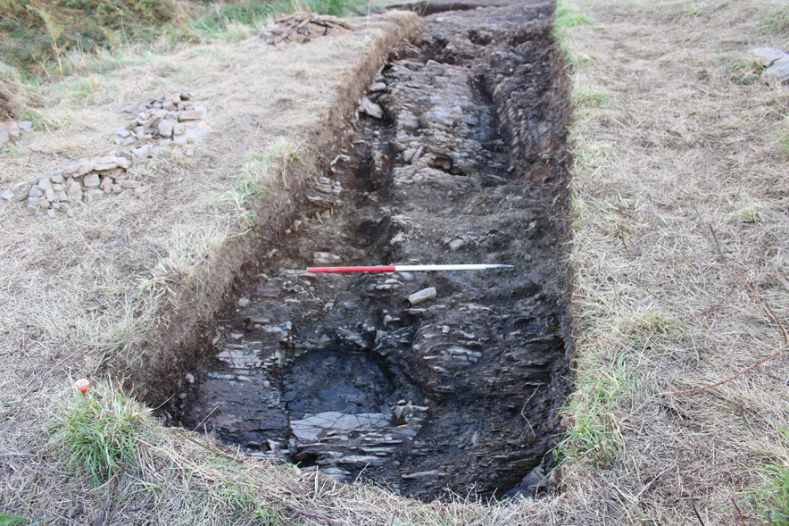
Upper rock cut hut platform
Notes:
Within the confines of the bedrock cut two phases of palisades and seemed to be a replacement for one another of slightly differing constructions.
The easterly of the two [1007] is believed to be the first and was a beam slot, although a direct stratigraphic relationship was difficult to establish (Photograph 32).
It ran southeast by northwest between two large well-constructed postholes packed neatly with large angular upright stones before turning northeast outside of the bounds of the trench.
The beam slot itself was a neat rectangular cut with upright packing stones along its length.

Slide 30
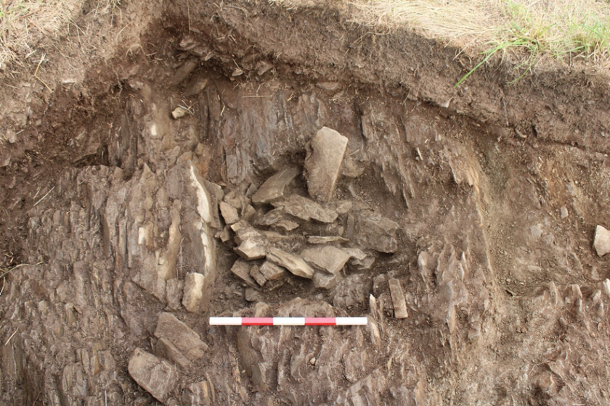
Stone packed post

Slide 31
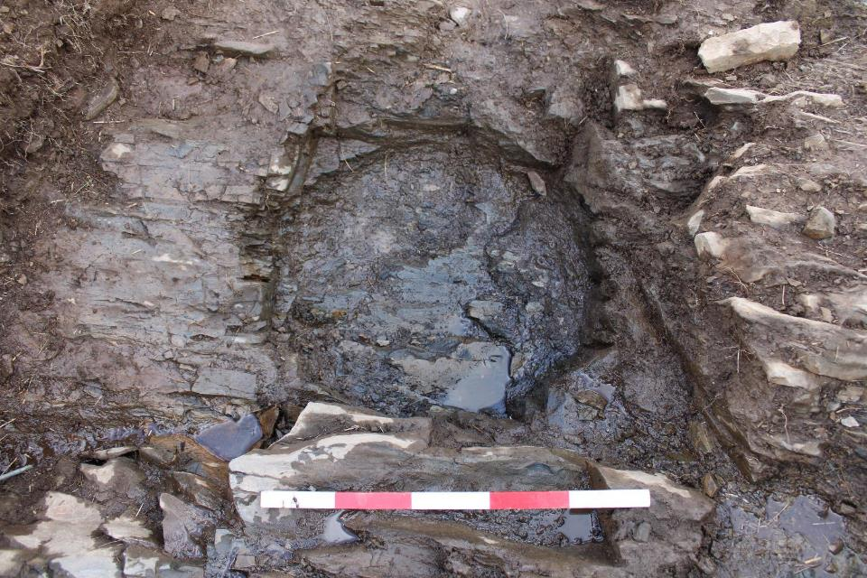
Porth y Rhaw July 2021 it’s been very hot

Slide 32
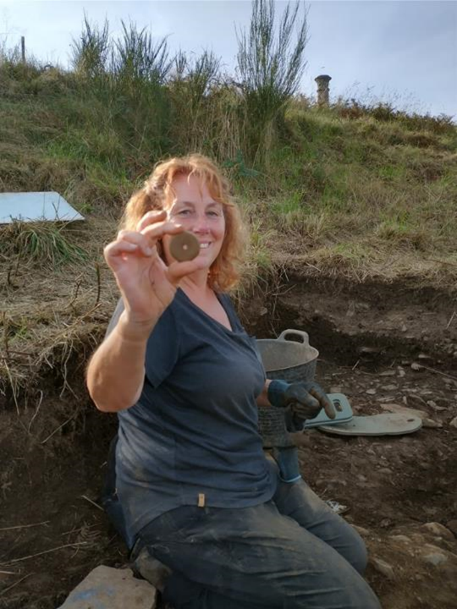
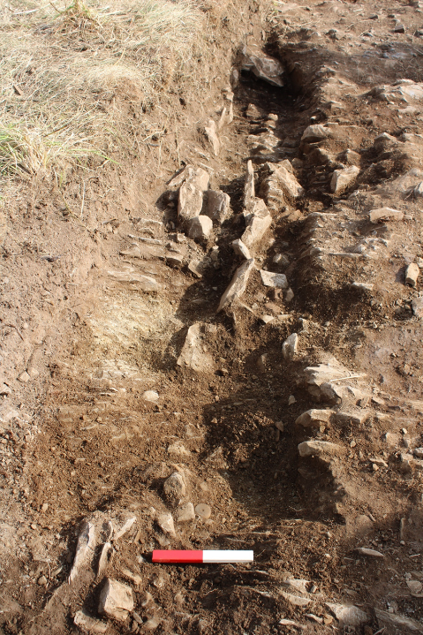
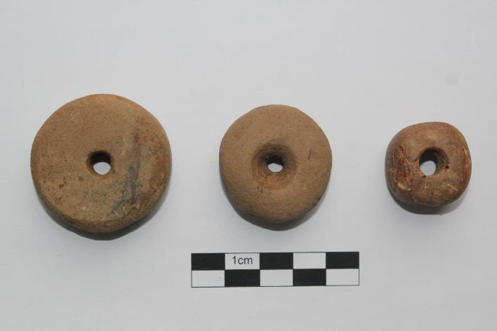
Palisade gully [1007] with packing stones and spindle whorl (SF 002) shortly after discovery.
Notes:
Within these remains two small finds were recovered. The first a neatly ground stone spindle whorl (SF 002) found within the beam slot [1007]. As well as a presumably imported amber bead (SF 003), in post hole [1009
The westerly of feature [1012] was a palisade trench with individual stake holes visible along its length which appears to have served as a replacement for beam slot [1007] although no return to the northeast was visible within the trench area (Photograph 35). A narrow deep posthole was located along its easterly edge [1033] (Photograph 36). The palisade trench was filled with a blackish silt (1011) with frequent shale inclusions with a few upright packing stones visible along its length. A stone bead (SF 004) was found within this fill.
Sealing all of the features in this area was a compacted blackish silt with flattened small angular stones (1023) thought likely to be remnants of slumped floor levels associated with the structures described above (Photograph 37 and 38). Notably, all of the small finds (SF 002-004) described associated with the structural remains underlie layer (1023) implying that they were deposited during construction rather than the use lifetime of the structures themselves.

Slide 33
Notes:
By the end of the Iron Age many people lived in hill forts. The forts were surrounded by walls and ditches and warriors defended their people from enemy attacks.
Inside the hill forts, families lived in round houses. These were simple one-roomed homes with a pointed thatched roof and walls made from wattle and daub (a mixture of mud and twigs).
In the centre of a round house was a fire where meals were cooked in a cauldron. Around the walls were jars for storing food and beds made from straw covered with animal skins.
Iron Age farmers grew crops and vegetables. They kept geese, goats and pigs and had large herds of cows and flocks of sheep. Some people worked as potters, carpenters and metalworkers. Men and boys trained as warriors. They had to be prepared to fight at any time.

Slide 34
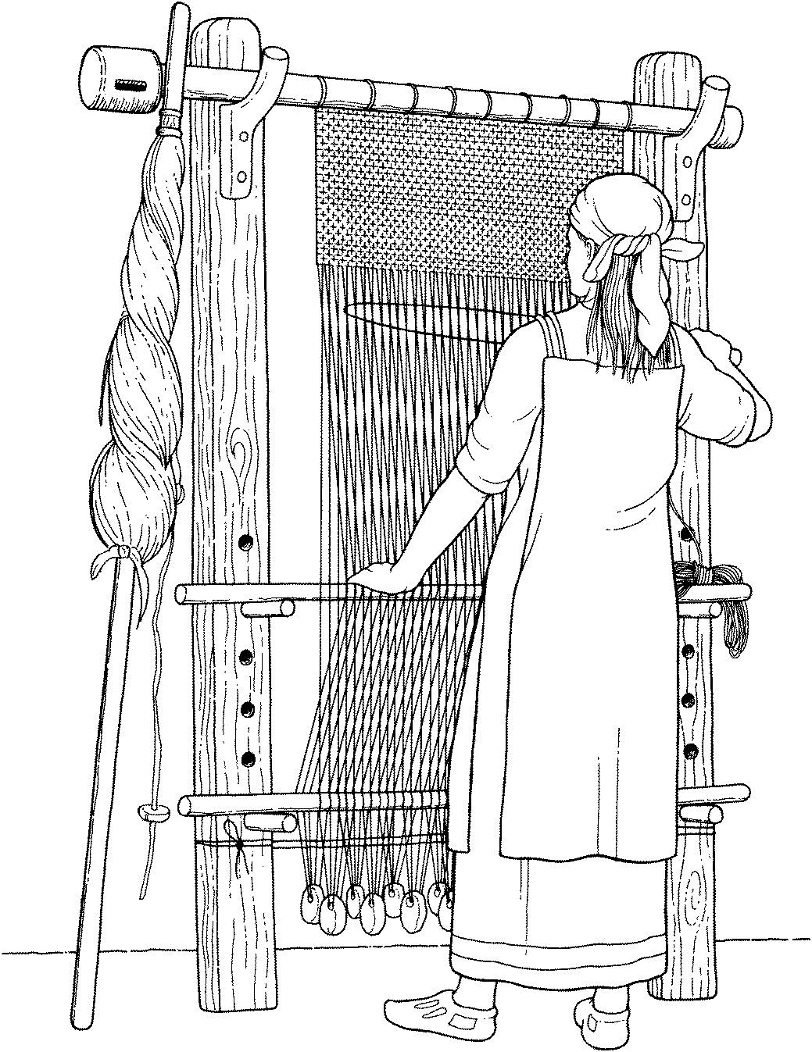

Slide 35
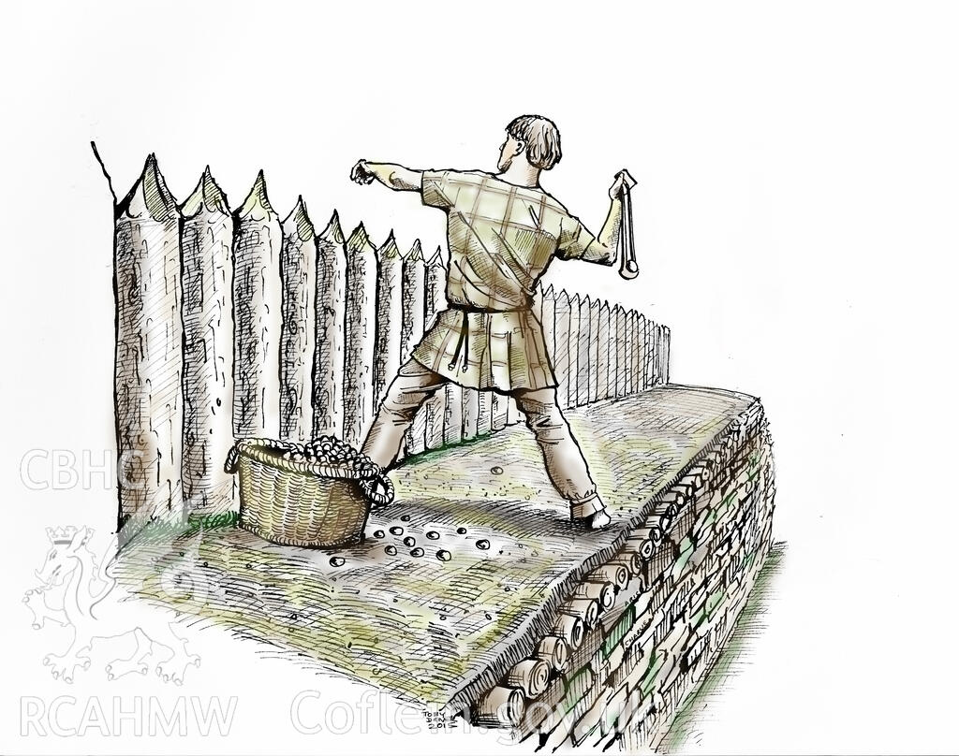

Slide 36
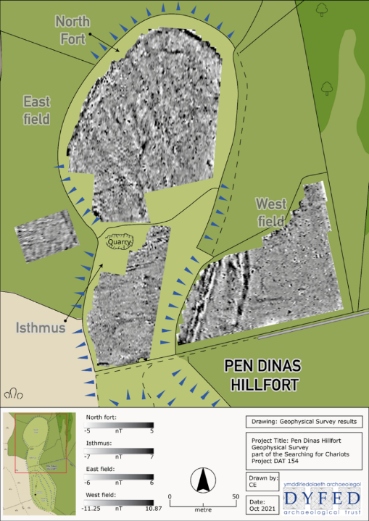
Notes:
And in 2021 we carried out more geophysics in the area of the northern fort and surrounding fields again funded by Cadw.
The results of the survey have confirmed the existence of outer ditches to the east of the fort as well as areas of potential Prehistoric activity within the interior of the north fort and the isthmus.
To the west of the fort, although ephemeral, possible features have been identified that could reflect activity taking place outside of the fort.

Slide 37
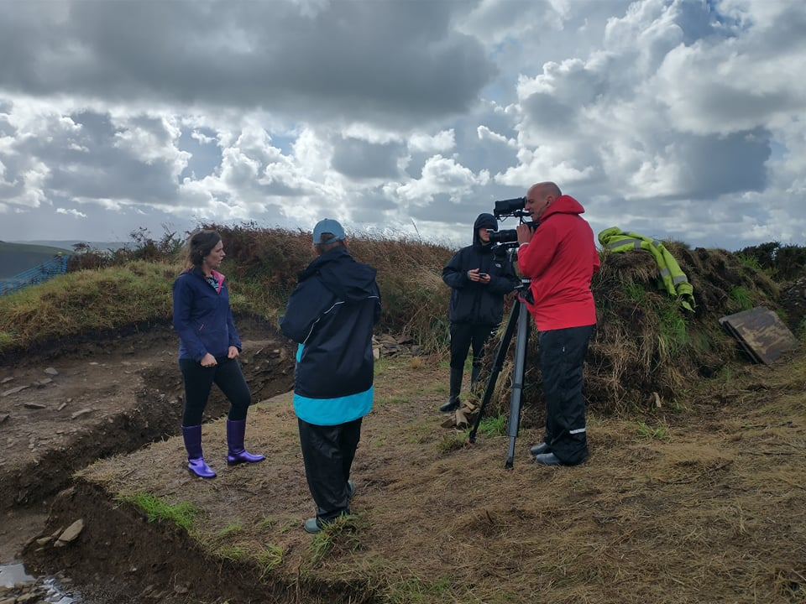

Slide 38
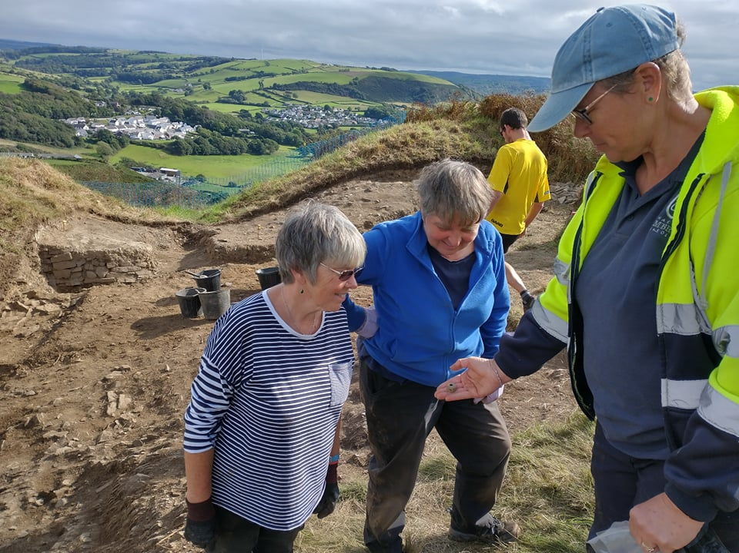
Notes:
45 volunteers and averaged 60 plus visitors a day

Slide 39
